Slide 1
How to do these simulations?
Trial available via www.comsol.com/contact
If you are interested -> contact me f. 1 month classroom licences.
Permanent licences ~ 5k - 10k€
Interface with 3D cad tools (e.g. Inventor)

Slide 2
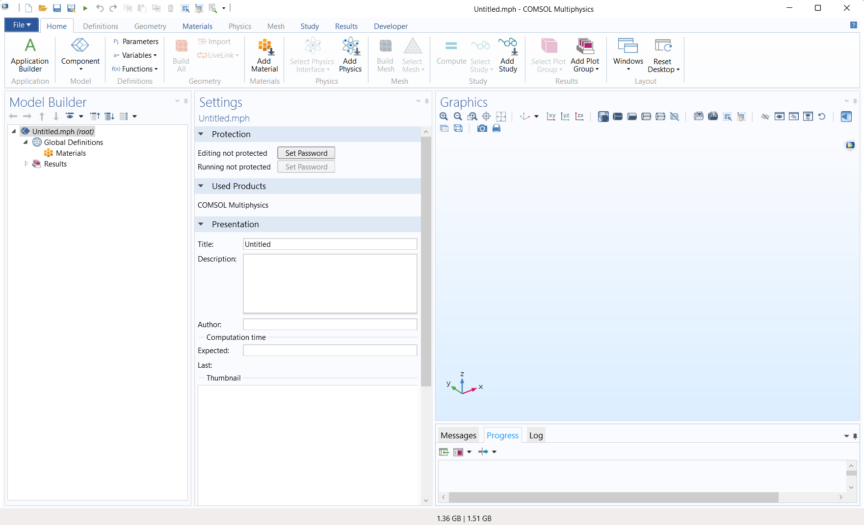
Step 0: Check out the user interface

Slide 3
Step 0: Check out the user interface
Commands (top), Tree (left), Settings (mid), Viewport (right), Progress/Notes (bottom)
make advanced sections visible -> important f. advanced physics (f. conservative form), equation view
Show help

Slide 4
Step 1: Define the geometry (2D, 3D, symmetries)
Create component
Always use lowest dimension size / highest symmetry possible.
Create 2D geometry with simple entities
Different shapes
Precise control
Domains, Edges, Points
Geometric operations on geometry:
Transforms: Array, copy, mirror, move, rotate, scale
Boolean ops: Union, intersect, difference, compose
Create 2nd file for 3D example:
Create 3D geometry
Same operations -> it gets tedious
Better: work with workplanes -> 3D operations (extrude etc.)
External CAD tools -> Inventor (free for University/students)
Load full chamber f. heat flow sim (later continue with 2D due to speed) via live-links
Upon import -> select repair-options

Slide 5
Step 2: Determine the necessary physics
1. Heat transport
2. Fluid motion
$$∇⋅q=−\frac{ρC_{p}∂T}{∂t}+Q$$
$$∇⋅\left(ρu\right)=−\frac{∂ρ}{∂t}$$
$$q≡−k∇T \\ Q≡heat source$$
$$\frac{ρ∂u}{∂t}⋅ρ\left(u⋅∇\right)u=∇⋅\left[−pI+τ\right]+F$$
Accel., convection
Hydrostatics, tension, ext force
3. Motion of dilute species
4. Reactions of species
$$∇⋅J=−{δc}/δt$$
$$J_{diff}=−D⋅∇c$$
$$∇⋅J=−{δc}/δt−Q_{R} \\ Q_{R} ≡source term$$
$$J_{drift}=v_{NS}⋅c+D_{T}∇T⋅c$$
e.g.
$$J=J_{diff}+J_{drift}$$
$$\frac{∂c_{2}}{∂t}=c_{1}^{2}⋅k_{on}−c_{2}⋅k_{off}=Q_{R,1}$$
$$\frac{∂c_{1}}{∂t}=−c_{1}^{2}⋅k_{on}+c_{2}⋅k_{off}=Q_{R,2}$$
lets add them stepwise – start with heat transport

Slide 6
Step 3: Material, boundary & initial conditions
Add blank materials:
PTFE:
0.27 W/mK
2200 kg/m^3
960 J/(kg*K )
Sapphire:
40 W/mK
4000 kg/m^3
750 J/(kg*K )
Assign material groups from inventor
Add „Heat transfer in solids“ -> add material properties
Set boundary temperatures (in experiment: defined by PID electronics)
Use parameters -> prevent „magic numbers“
units added in brackets: e.g. [m^2], also non-UI units possible.
Duplicate boundary cond-nodes to save time
Mesh-error -> make finer mesh

Slide 7
Step 4: Set solution type
Steady state for heat transfer
Parametric sweep f. multiple runs

Slide 8
Step 5: Analyse results
Temperature
3D surface
3D Slices
Data-set -> Cut-planes, cut-lines
Heat flux:
Arrow-volume
Isosurface -> multiple, or 1 (with slider)

Slide 9
Improving the mesh
Rule: Reduce number of elements as much as possible to maintain the projected precision.

Slide 10
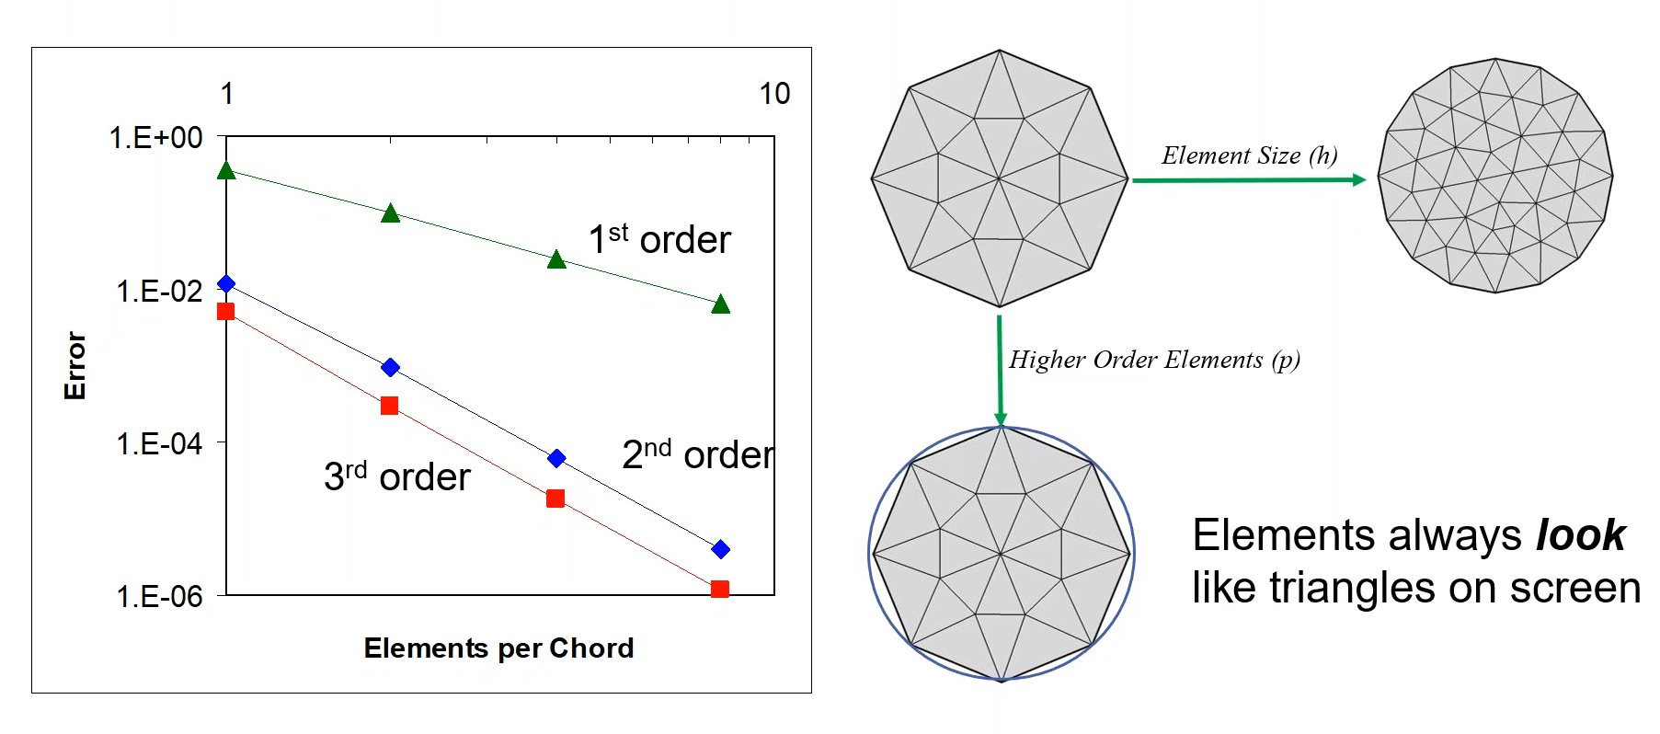
Improving the mesh
set in component -> „shape order“ & discretization node in physics nodes
Notes:
Comsol always uses 2nd order elements by default

Slide 11
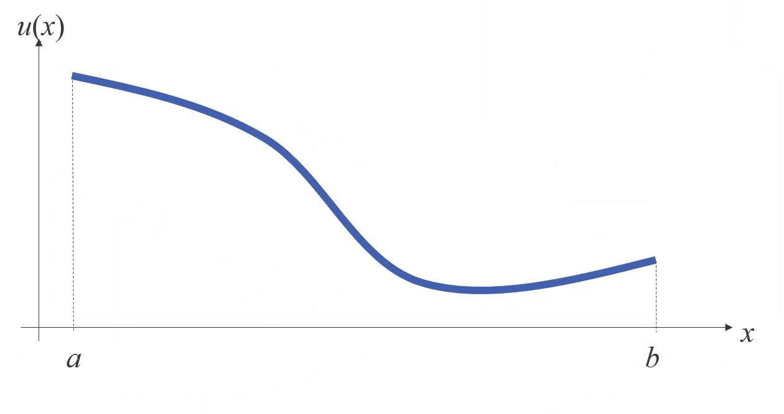
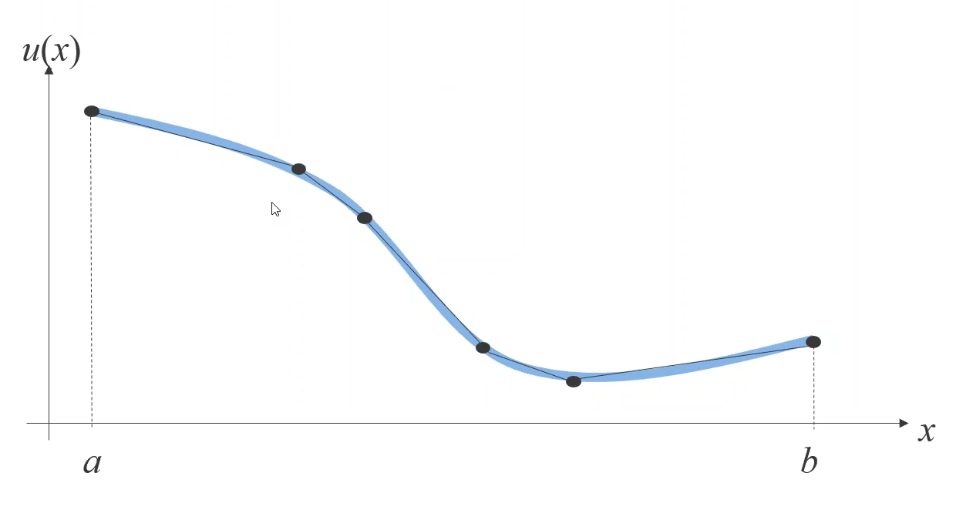
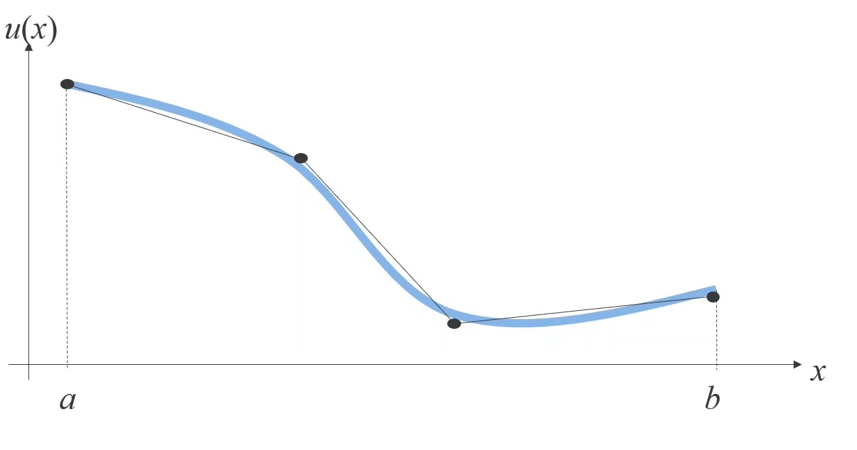
Element order - visualization
Example: 1D solution
this is the „correct“ result
Better: same order, but more elements & not uniform
Bad: low number, low order
Notes:
Comsol always uses 2nd order elements by default

Slide 12
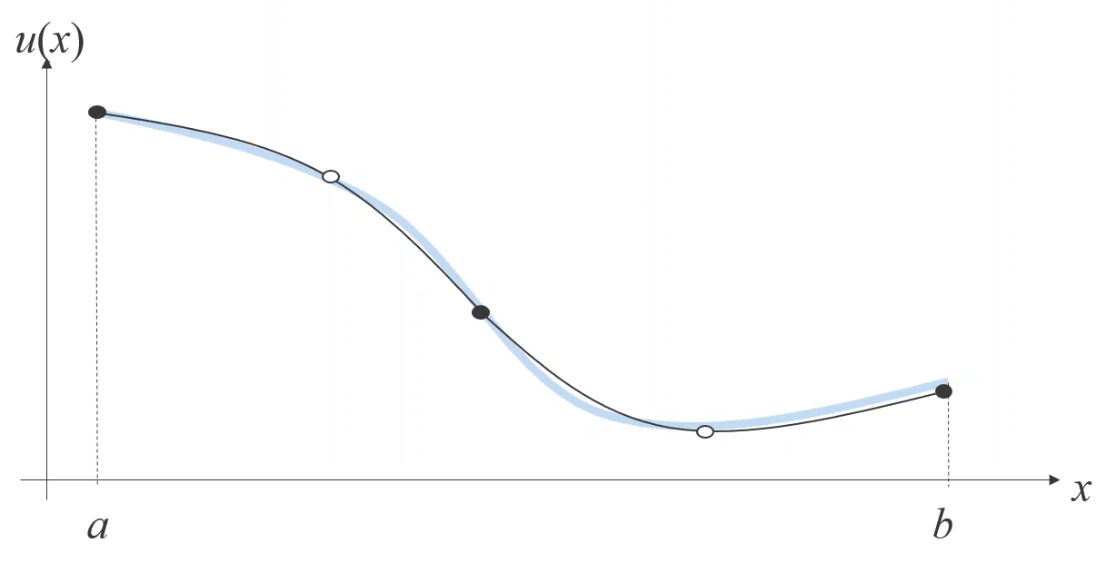
Element order - visualization
Example: 1D solution
this is the „correct“ result
Even better: higher order, very low number of
Notes:
Comsol always uses 2nd order elements by default, except NS bc of stabilization.

Slide 13
Notes:
Comsol always uses 2nd order elements by default, except NS bc of stabilization.

Slide 15
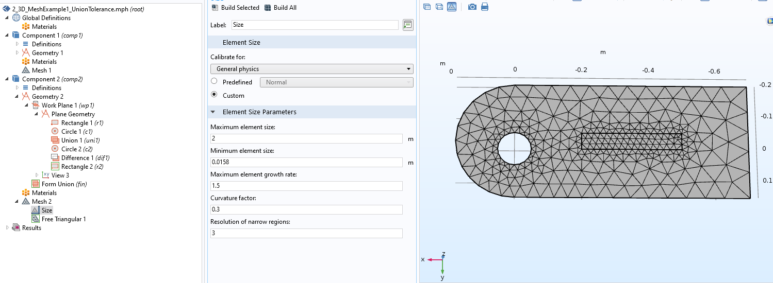
Basic „tricks“
Set appropriate repair tolerance on union operation (example: 2_3D..)
Use „de-featuring“ operations on geometry node
Also use domains to assign mesh nodes with size-subnodes
Try around with other mesh types (quad, mapped w. distribution subnode)
Hard to predict which mesh types are optimal (depends on problem)
Plot mesh quality to verify (with element filter), mesh quality histogram
Use Geometry -> Virtual operations -> Mesh control edges to use edges only for meshing (without being its own domain)!
Composite faces (e.g. cylinder) -> unify faces to simplify meshing (use explicit selection)

Slide 16
Step N: Repeat steps 1-5 f. other physics models@2D
Redo sim 2D with simple rectangle geometry
Global vs local parameter
Setting local parameters (D = 100e-12[m^2/s], ST=0.03[1/K], DT)
Setting up geometry (parametrized dimensions -> to global parameters)
Add Materials (water), show properties, also Temp dependent etc.
Setup heat conduction, navier stokes equation, movement of dissolved species (go through all elements)
Compressible flow + Conservative particle flux
Zero pressure boundary conditions
Concentration boundary condition
Setup solver -> subsequent solution instead of „all in one“
2x steady state + 1x time dependent
Visualize results
Add flow through boundary @ NS
Add simple reaction term using 2 species (kon: 1e-2[1/(Ms)], koff: 1e-3[1/s]), 24[h] (using 2nd TDS node)
Timefact:0.0001, DT1=10x DT2
Evaluate using integration
Width: 170um, Height: 20mm

Slide 17
Labview Homework – solutions (see lecture files)
1. Implement a VI that creates an array of Strings of length N that contain all possible sequences with a given alphabet (e.g. {A,G,C,T}).
2. Implement a VI that creates an array of Strings of length N, where each string is assembled randomly step by step from a pool of building blocks with a predefined concentration.
3. Extend the VI from 2. by making the assembly process dependent on the previously attached building block.
4. Create a sequence-histogram from the array of strings/sequences produced by 2. and 3. and display them using a X-Y-Plot.
4. Create a sequence-histogram of sub-mers of predefined length from the array of strings/sequences produced by 2. and 3. and compare both datasets.

