Slide 1
Thermophoresis Intro
Systems Biophysics Group
Christof Mast
Systems Biophysics
Tel: 08921801484
https://www.biosystems.physik.uni-muenchen.de/

Slide 2
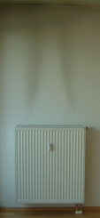
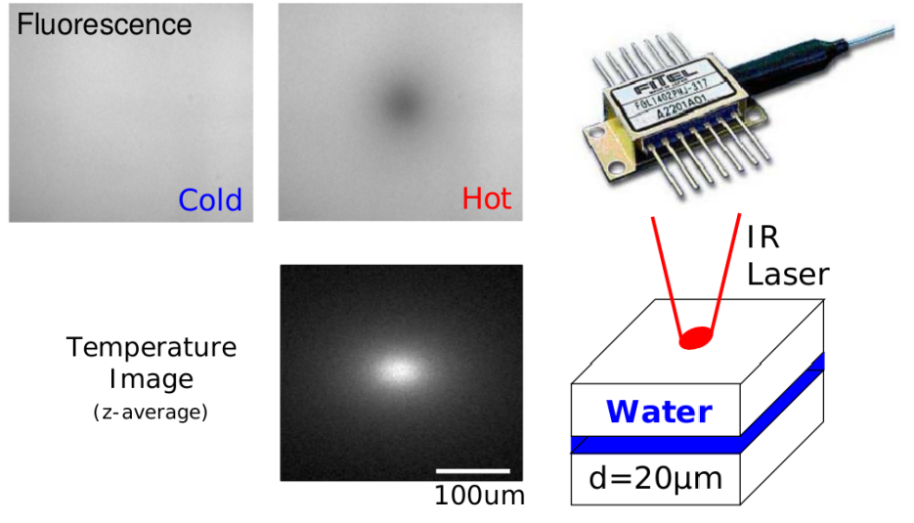
Intro: Thermophoresis
Definition: „Movement of molecules along a thermal gradient“
Here: Charged molecules in water (DNA, proteins..)

Slide 3
Intro: Thermophoresis
$$\vec{j}=−D_{T}∇Tc−D∇c$$

Slide 4
But we know:
total differential f. G(T,p,N)
10.1073/pnas.0603873103

Slide 5
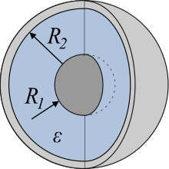
$$G_{ion}\sim Energy of spherical capacitor$$
$$G_{ion}=\frac{1}{2}⋅\frac{Q^{2}}{C}, \frac{1}{C}=\frac{1}{4πε}⋅\left(\frac{1}{R_{1}}−\frac{1}{R_{2}}\right)$$
$$R_{1}\sim λ_{DH}\left(T\right)=\sqrt{\frac{ε\left(T\right)ε_{0}kT}{2e^{2}c_{s}}},R_{2}→ ∞$$
Entropy of hydration
Contribution by „capacitor effect“
10.1073/pnas.0603873103

Slide 6
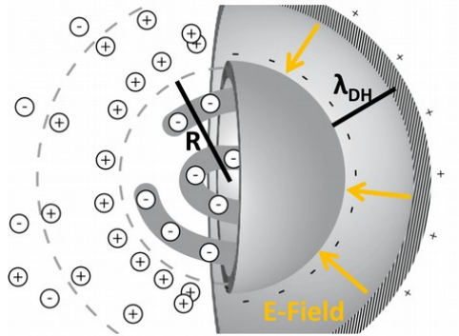
Intro: Thermophoresis
Different contributions
1. Capacitor effect
CM

Slide 7
2nd order effects: also salt ions have thermophoresis
Flux of species i:
$$\vec{j_{i}}=−D_{T,i}∇Tc_{i}−D_{i}∇c_{i}+{ez}_{i}μ_{i}c_{i}E$$
Coupled via unknown field E
Equilibrium:
$$0=−D_{T,i}∇Tc_{i}−D_{i}∇c_{i}+ez_{i}μ_{i}c_{i}E$$
Multiply with
$$\frac{z_{i}}{D_{i}}$$
Sum over all species
$$\frac{Ee}{kT}∑{z_{i}^{2}c}_{i}=∇T∑z_{i}c_{i}\left(\frac{D_{T,i}}{D_{i}}\right)$$
Using charge neutrality:
$$E=∇T⋅\frac{kT}{e}⋅\frac{\left(∑z_{i}c_{i}\left(\frac{D_{T,i}}{D_{i}}\right)\right)}{∑z_{i}^{2}c_{i}}$$
$∑z_{i}⋅\frac{dc_{i}}{dx}$ ~ 0
Multiply with
An use
$$μ_{DNA}$$
$$D_{T,DNA }⋅∇T=−v$$
$$D_{T,DNA}/μ_{DNA}$$
10.1103/PhysRevLett.112.198101

Slide 8
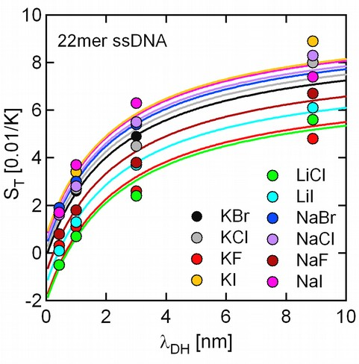
Intro: Thermophoresis
Different contributions
2. Seebeck effect

Slide 9
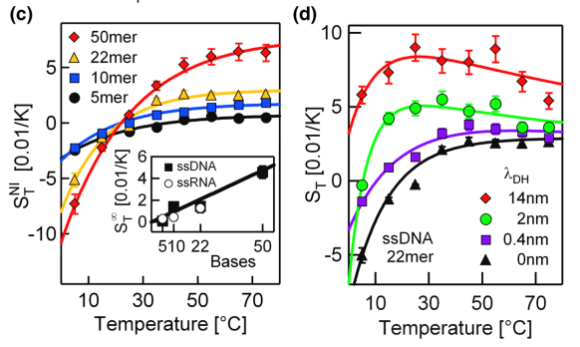
Intro: Thermophoresis
Total effect
Empirical contribution

Slide 10
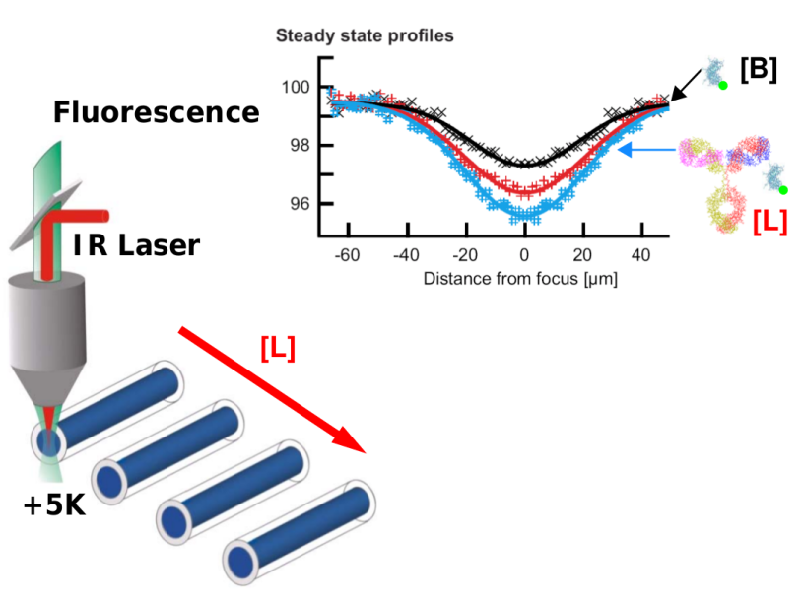
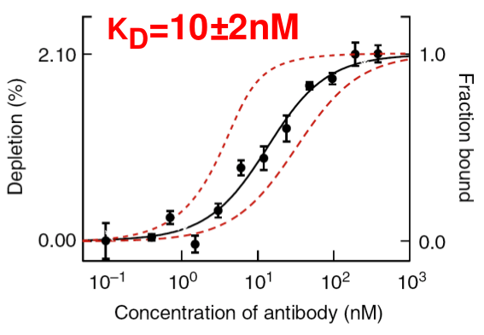
Intro: Thermophoresis
Applications
B
LB

Slide 11
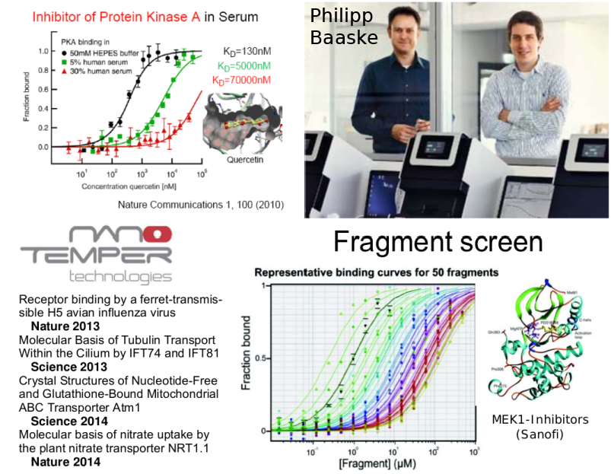
Intro: Thermophoresis
Stefan
Duhr

Slide 12
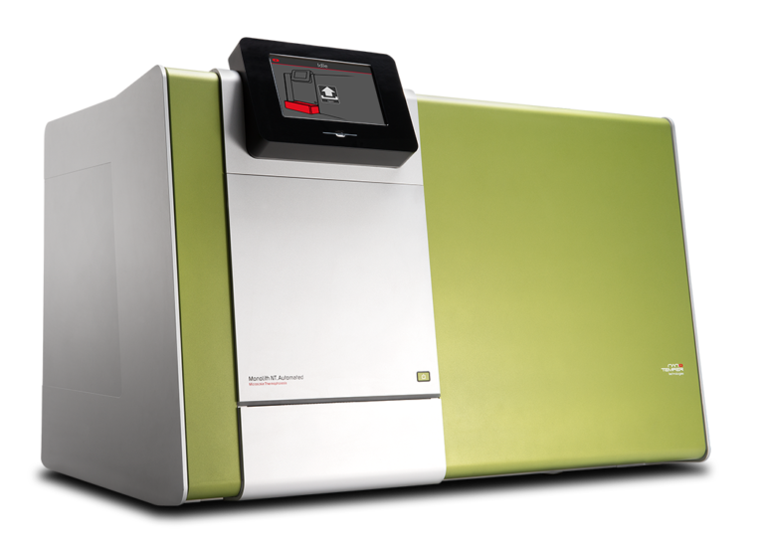
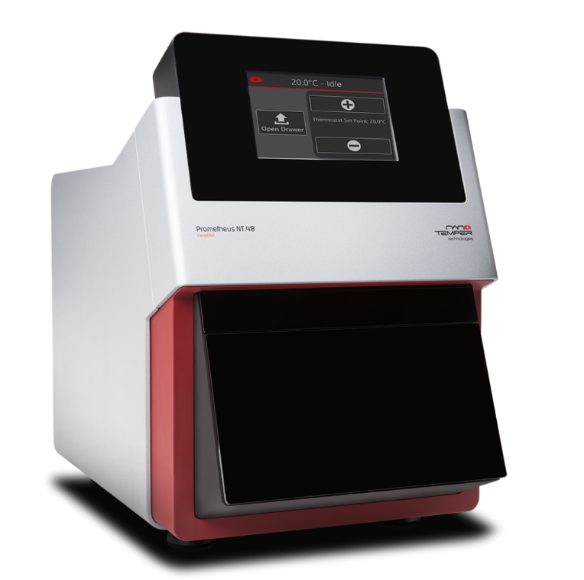
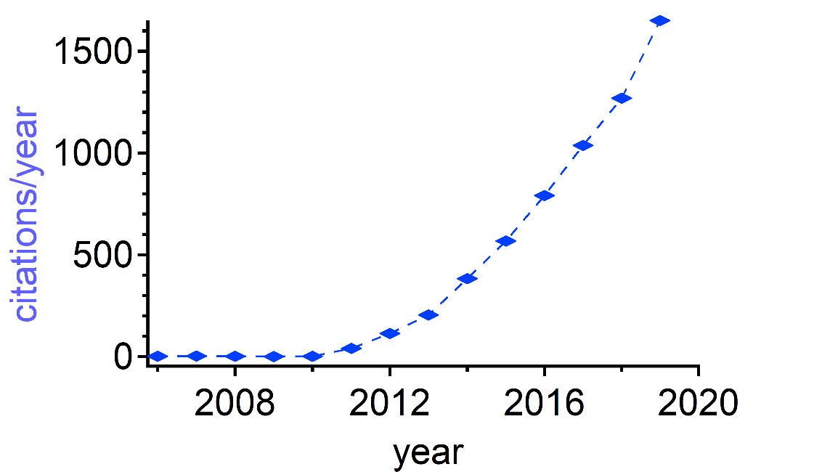
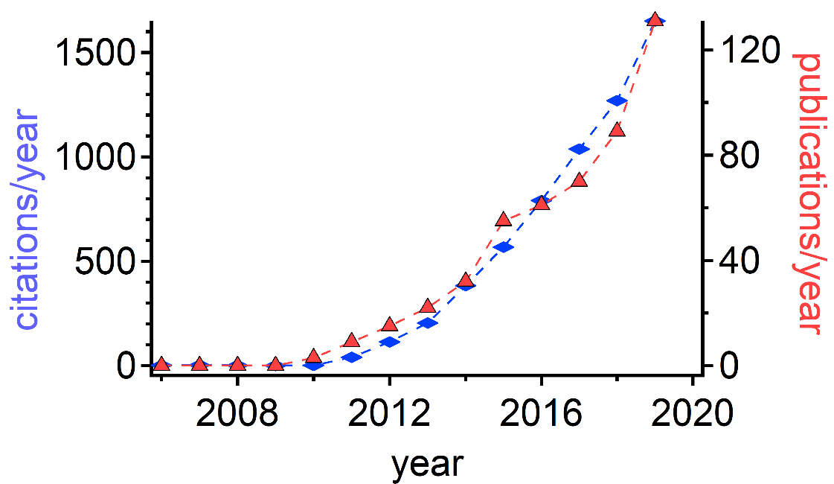
Intro: Thermophoresis
Stefan
Duhr

Slide 13
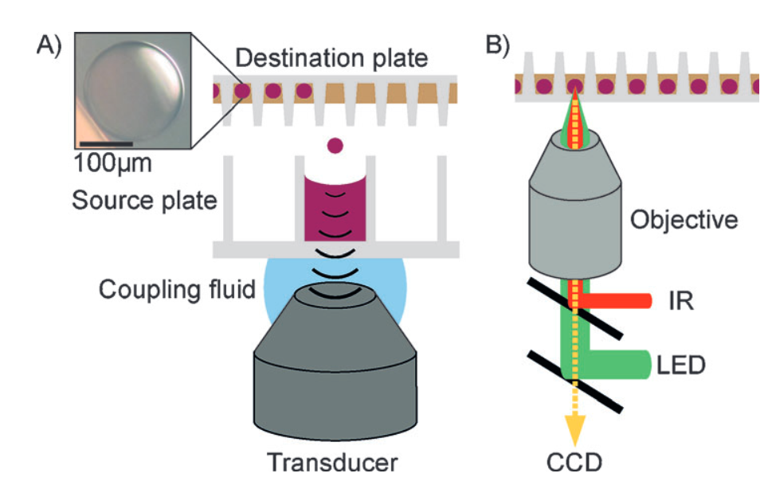
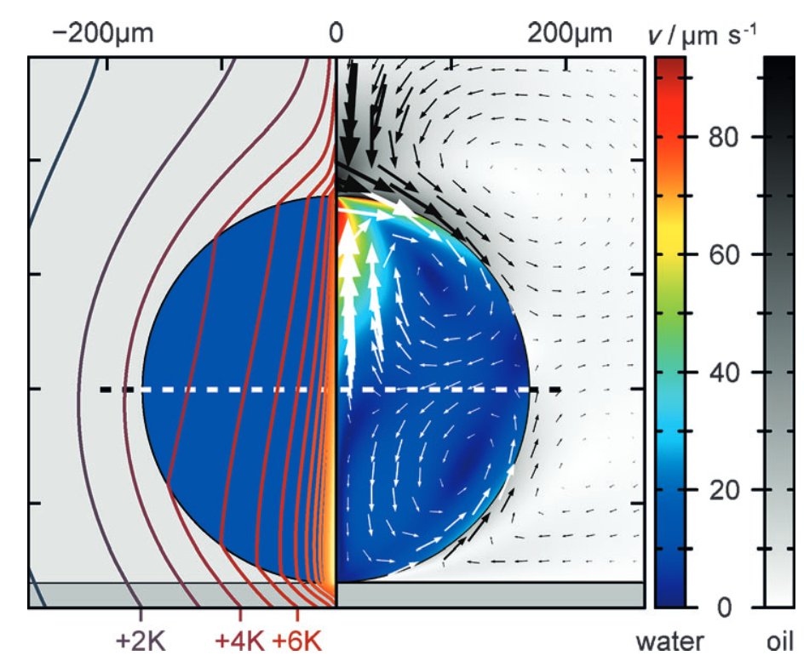
Thermophoresis (high throughput)
Binder-Ligand-Titration by pipetting robot/transducer
Full characterization by finite element models
Measurement in droplets!
10.1002/anie.201402514

Slide 14
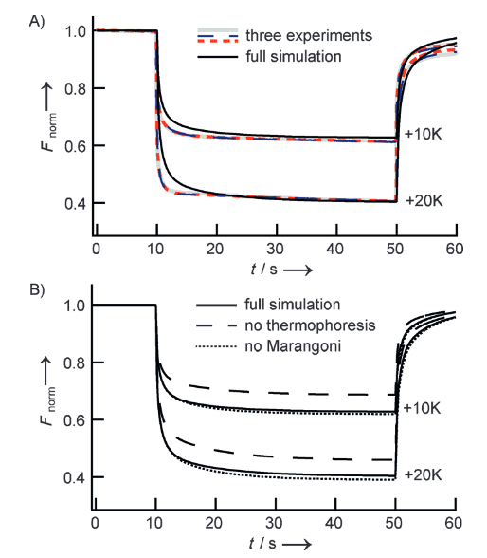
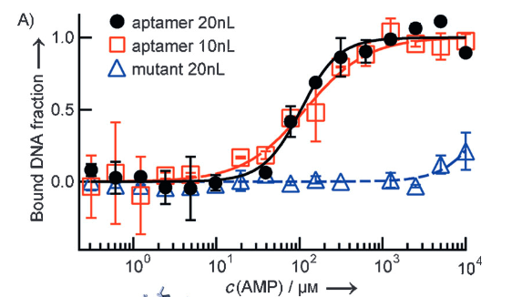
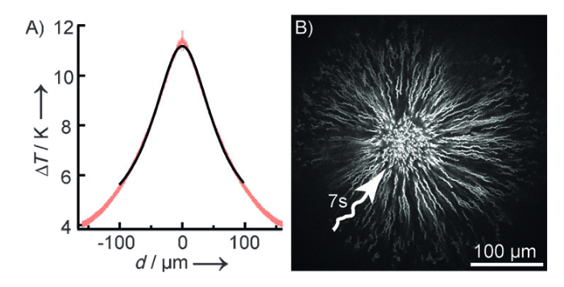
Thermophoresis (high throughput)
Tracking fluorescence in droplet center
Visualization of thermal profile by tracking fluorescent beads.
10.1002/anie.201402514

Slide 15
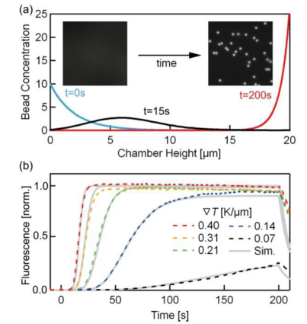
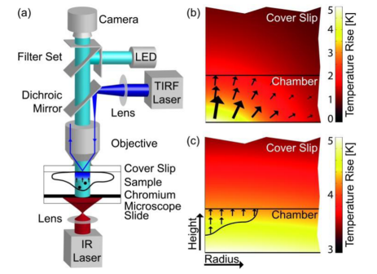
Thermophoresis inside living cells
10.1021/ja506169b
Notes:
Explain TIRF + 2nd figure b) movement ov beads

Slide 16
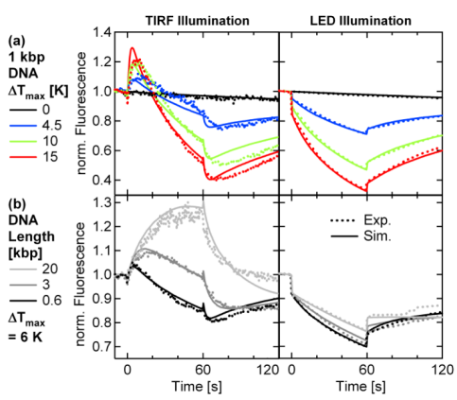
Thermophoresis inside living cells
10.1021/ja506169b

Slide 17
Addon: Boltzmann distribution
kleines System mit Energie $E_{r}$ mit r Microzuständen gleicher
Wahrscheinlichkeit $P_{r}$
Kanonisches Ensemble:
System in Kontakt mit Wärmebad, d.h. definierte Temperatur T
- Bad mit Energie $E_{B}$, Temp: T
- $Ω_{B}$=Anzahl d. Mikrozustände gleicher Wahrscheinlichkeit
Anzahl aller möglichen Zustände: $Ω\left(E\right)$
Gesamtenergie $E=E_{B}+E_{r}$
Frage: Wie hoch ist $P_{r}$ , bei einer Bad-Temperatur T, wenn das kleine System eine bestimmte Energie $E_{R}$ hat?
$$P_{r}=\frac{Ω_{B}\left(E−E_{r}\right)}{Ω\left(E\right)}$$
Entwickle $ln\left(Ω_{B}\left(E−E_{r}\right)\right)$ nach E um $E_{r}$ (weil $ln\left(Ω\right)\sim S$ und Definition Temperatur: $\frac{1}{T}≡\frac{∂S}{∂E}$)
$$ln\left(Ω_{B}\left(E−E_{r}\right)\right) =ln\left(Ω_{B}\left(E\right)\right)−\frac{∂\left(lnΩ_{B}\left(E\right)\right)}{∂E}⋅E_{r}+…\sim ln\left(Ω_{B}\left(E\right)\right)−βE_{r}$$
$$P_{r}\left(E_{r}(x)\right)=\exp\left(−βE_{r}\left(x\right)\right)$$
wg Erdodenhypothese (Ensemblemittel ~ Zeitmittel) -> $P_{r}\left(E_{r}\left(x\right)\right)\sim c\left(x\right)$ in Potential $E_{r}\left(x\right)$

Slide 18
Addon: Debye Hückel Theory
Possion equation:
$$∇^{2}φ=−\frac{ρ}{εε_{0}}$$
Def. charge densitiy:
$$ρ=\sum_{i}{c_{i}z_{i}}e_{0}$$
use Boltzmann distri.:
$$c_{i}\left(r\right)=c_{i,0}\exp\left(−\frac{z_{i}e_{0}φ\left(r\right)}{k_{B}T}\right)$$
$$Δφ=−\sum_{i}{\frac{z_{i}e_{0}c_{i,0}}{εε_{0}}\exp\left(−\frac{z_{i}e_{0}φ\left(r\right)}{k_{B}T}\right)}$$
combine above equ.:
1st order of exp(x) &
charge neutrality:
$$Δφ=\sum_{i}{\frac{z_{i}^{2}e_{0}^{2}c_{i,0}}{εε_{0}k_{B}T}φ(r)}$$
$κ≡\sqrt{\sum_{i}{\frac{z_{i}^{2}e_{0}^{2}c_{i,0}}{εε_{0}k_{B}T}}}$
Definition of Debye-Hückel Length
$$λ_{DH}≡\frac{1}{κ}={\left(\sum_{i}{\frac{z_{i}^{2}e_{0}^{2}c_{i,0}}{εε_{0}k_{B}T}}\right)}^{−\frac{1}{2}}$$
Laplace in spherical
coordinates + symmetry:
$$\frac{1}{r^{2}}⋅\frac{∂}{∂r}\left(r^{2}⋅\frac{∂φ}{∂r}\right)=κ^{2}φ(r)$$
DGL solution:
$$φ\left(r\right)=\frac{a}{r}\exp{(−κr)}$$

