Slide 1
Inverse Problems and Machine Learning in Medical Physics
Tutorial: Introduction to Python
Ines Butz
07/11/2023
ines.butz@physik.uni-muenchen.de

Slide 2
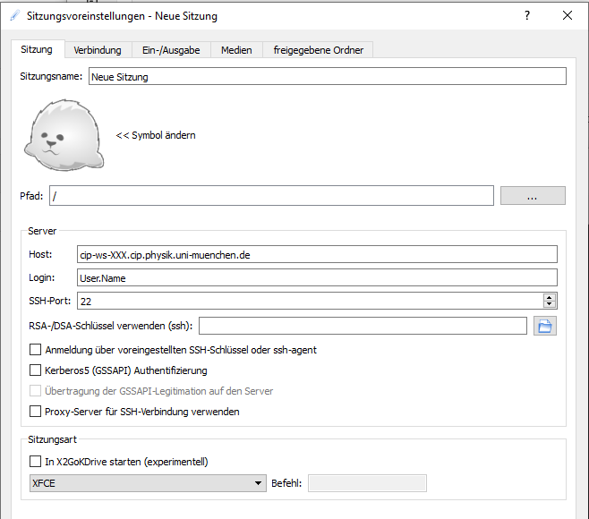
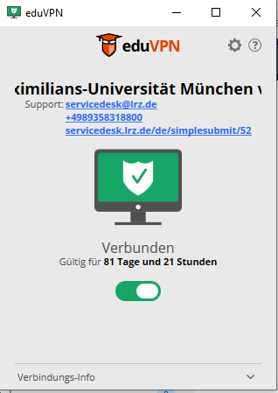
Getting started
Computational Resources
Use your own device (need python installation)
OR
Connect to a Linux machine in the LMU physics CIP pool via X2Go
Connect to LRZ via VPN: Instructions
Set up remote connection to Linux machine (currently no documentation ☹) → ask me if help needed!

Slide 3
Getting started
Set up your python environment
We use python version 3.10
Code will be presented as jupyter notebook
Recommended: work with anaconda or virtual environment
Anaconda (Linux)
venv (Linux)
module load python conda init bash conda create –p /path/../my_env
conda activate /path/../my_env
module load python python –m venv /path/../my_env
source path/../my_env/bin/activate
(only once)
Install required python packages (environment.yml, requirements.txt available on gitlab, see next slide, download/clone, navigate to folder)
Anaconda (Linux)
venv (Linux)
conda env update –p /path/../myenv --file environment.yml
pip install –r requirements.txt

Slide 4
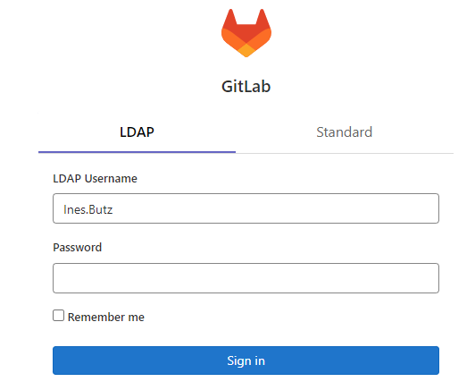
Getting started
GitLab repository
Access the code of the tutorial at: https://gitlab.physik.uni-muenchen.de/Ines.Butz/tutorials-inverse-problems-and-machine-learning-in-medical-physics
Log in with your LMU account without @physik.uni-muenchen.de or @campus.lmu.de
Set up a directory for the repository on your machine
mkdir /path/to/tutorial
Within this directory, clone the repository
Git clone https://gitlab.physik.uni-muenchen.de/Ines.Butz/tutorials-inverse-problems-and-machine-learning-in-medical-physics.git
Start jupyter
jupyter notebook

