Slide 1
DNA Catalysed Networks
Based on the Paper „Engineering Entropy-Driven Reactions and Networks Catalyzed by DNA”
Held by Benjamin Kahlert And Lucas Fochler
25.11.2019

Slide 2
Logic Circuts
Requirements:
Distinct signals
Gate specificity regarding inputs and
Signal amplification capable Gates
Unrestricted chaining of Gates and signals
DNA as an exellent
choice
Notes:
Finally, there should be no leak or crosstalk between distinct signals and gates.

Slide 3
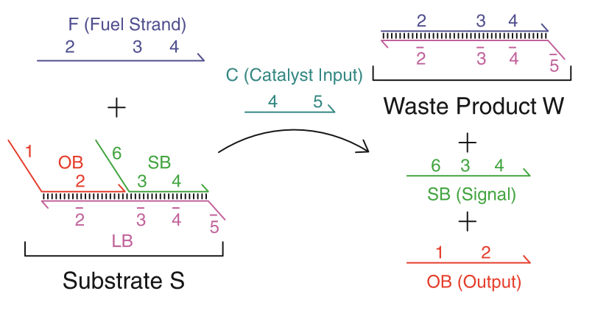
Basic Circut Principle

Slide 4
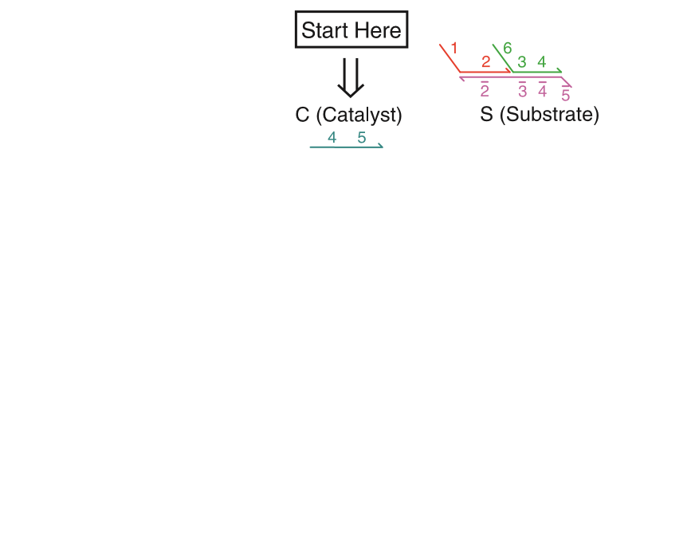
„Reaction“ Process
Notes:
Toe hold domain: 4-10 nucleotides

Slide 5
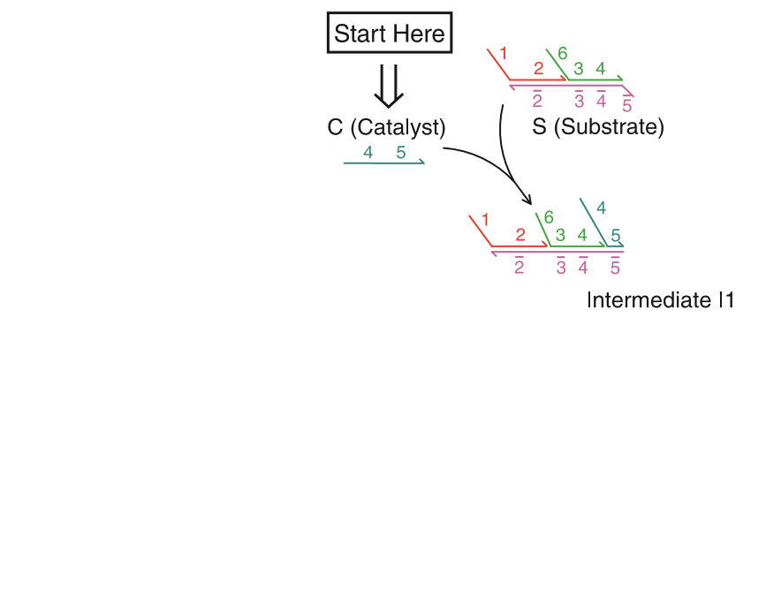
„Reaction“ Process
Notes:
Toe hold domain: 4-10 nucleotides

Slide 6
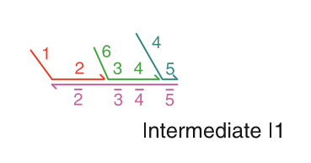
„Reaction“ Process
„Toe-hold“ domain
(3,5)
“specificity” domains
(1,2,4,6)
Notes:
Toe hold domain: 4-10 nucleotides

Slide 7
„Reaction“ Process
Notes:
Toe hold domain: 4-10 nucleotides
branch migration

Slide 8
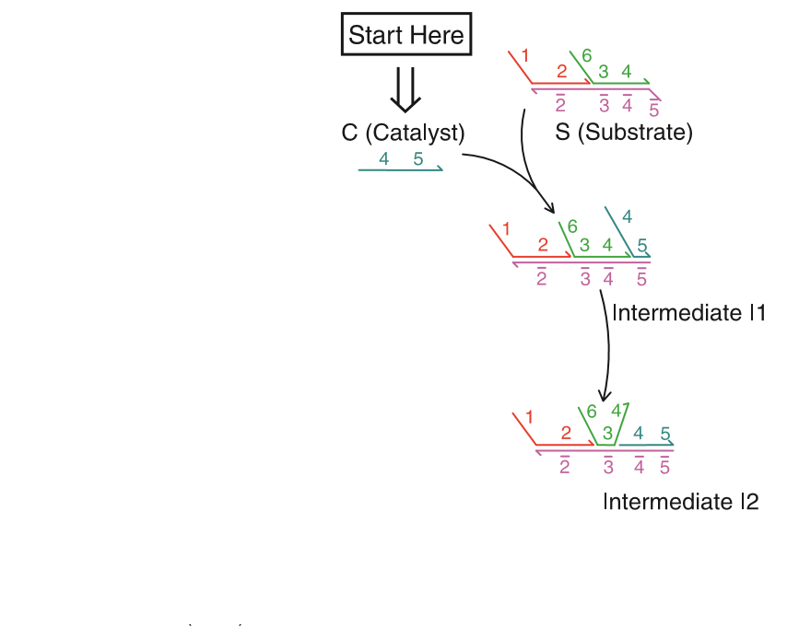
„Reaction“ Process
Notes:
Toe hold domain: 4-10 nucleotides

Slide 9
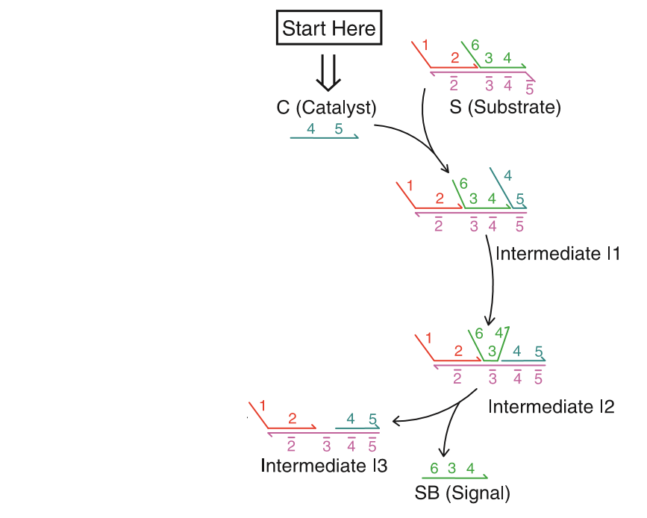
„Reaction“ Process
Notes:
Toe hold domain: 4-10 nucleotides

Slide 10
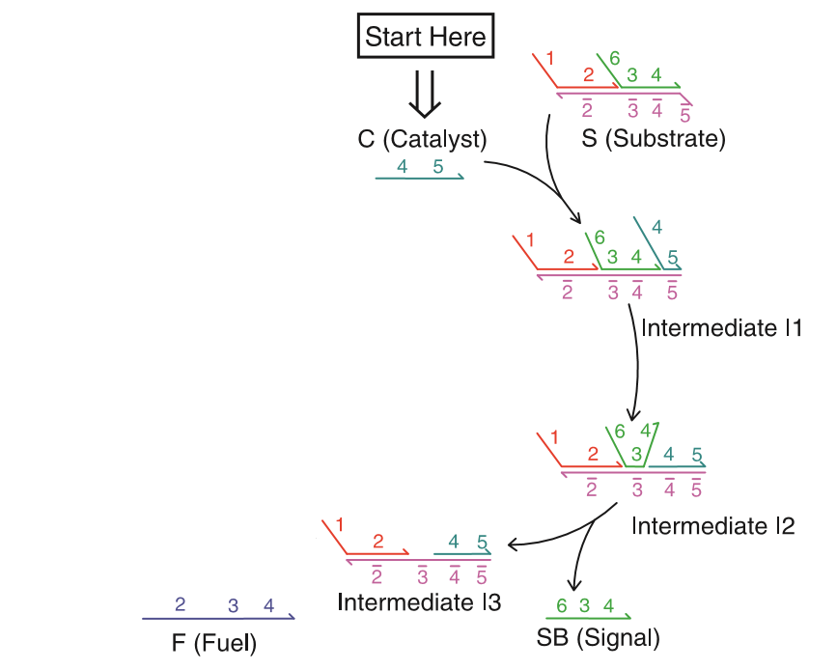
„Reaction“ Process
Notes:
Toe hold domain: 4-10 nucleotides

Slide 11
„Reaction“ Process
+
Notes:
Toe hold domain: 4-10 nucleotides

Slide 12
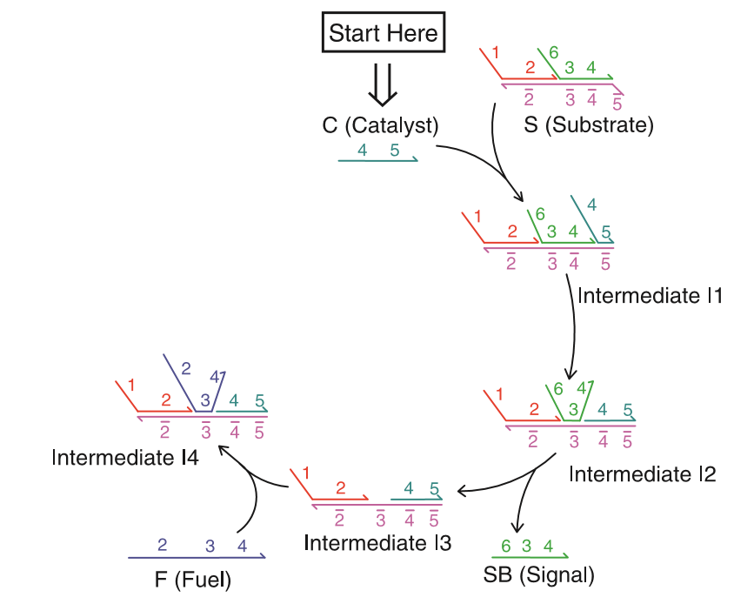
„Reaction“ Process
Notes:
Toe hold domain: 4-10 nucleotides

Slide 13
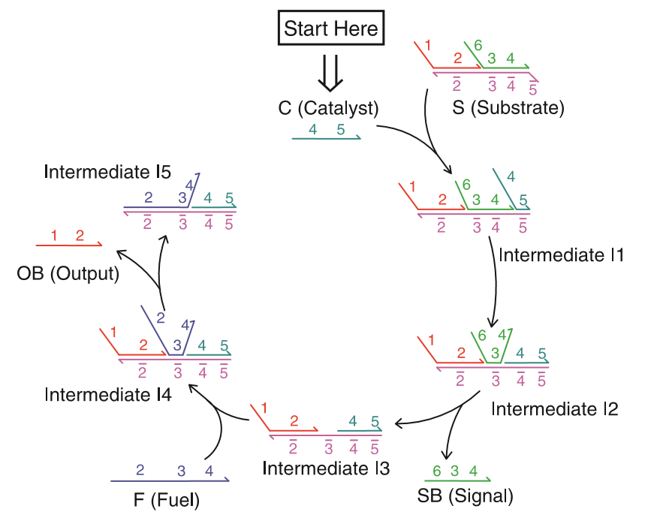
„Reaction“ Process
Notes:
Toe hold domain: 4-10 nucleotides

Slide 14
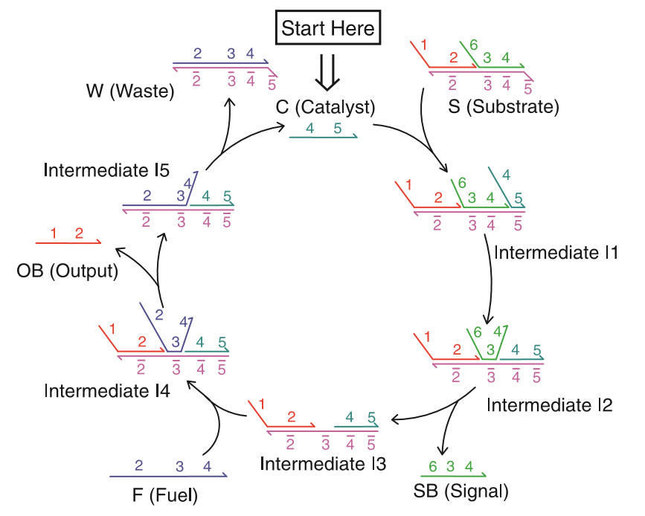
„Reaction“ Process
Notes:
Toe hold domain: 4-10 nucleotides

Slide 15
The Driving force of the process
dG= VdP –SdT
∆G < 0 “Reaction” towards products
∆G = 0 “Reaction” stops

Slide 16
The Driving force of the process
dG= VdP –S dT
dG= nRT dP/P
G-G₀ = nRT ln(P_{f} /P_{i} )
V=nRT/P
∆G = G_{0,OB} + G_{0,SB} + G_{0,W} − G_{0,S} − G_{0,F} + RT ∑ n_{l} ln(P_{f, l} / P_{i, l})

Slide 17
The Driving force of the process
dG= VdP –S dT
dG= nRT dP/P
G-G₀ = nRT ln(P_{f} /P_{i} )
V=nRT/P
∆G = G_{0,OB} + G_{0,SB} + G_{0,W} − G_{0,S} − G_{0,F} + RT ln(Q)

Slide 18
The Driving force of the process
dG= VdP –S dT
dG= nRT dP/P
G-G₀ = nRT ln(P_{f} /P_{i} )
V=nRT/P
∆G = ∆ G_{0,net} + RT ln(Q)

Slide 19
The Driving force of the process

Slide 20
Experimental validation and simulation

Slide 21
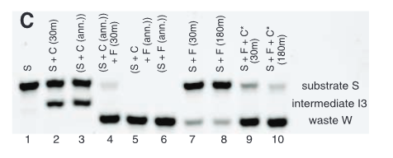
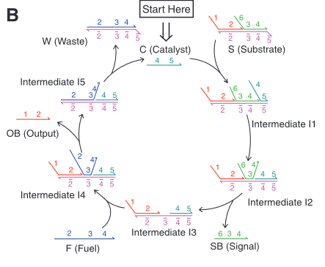
PAGE diagnostic
Reactions up to I3 are fast (line 2)
Subsequent reactions of I3 and F are fast (lines 3 and 5)
Uncatalyzed reaction is slow (lines 7 and 8)
C enables the reaction to proceed rapidly

Slide 22
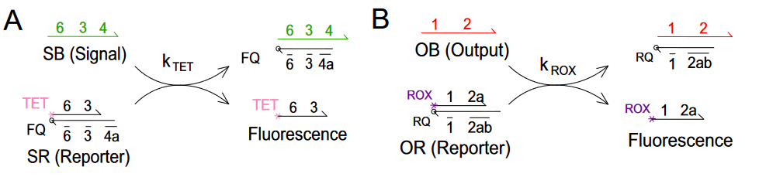

Measurement technique
The number of produced OB or SB was analysed via indirect fluorescence reporter
$k_{TET}$ and $k_{ROX}$ were fitted and found to be $8∗{10}^{5}M^{−1}s^{−1}$ and $4∗{10}^{5}M^{−1}s^{−1}$ respectively

Slide 23
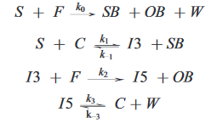


Analysis of the time course
Simulation:
System is modeld via rate equations
Assumpltions: $k_{−1}=k_{2} , k_{1}=k_{−3}$ due to symmetrie
$k_{3}$ was identified via fitting
The rest of the constants were measured
Reaction is accelerated by 4 orders of magnitude
${ k}_{0} =2.3 ⋅$ ${10}^{1} M^{−1}s^{−1}$
${ k}_{1} =6.5 ⋅$ ${10}^{5} M^{−1}s^{−1}$
${ k}_{2} =$4.2 $⋅$ ${10}^{5} M^{−1}s^{−1}$
${ k}_{3} =$ 4 $⋅$ ${10}^{−3} s^{−1}$ (fitted)

Slide 24
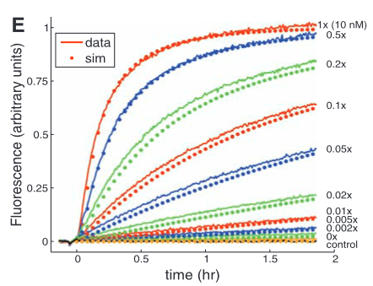
Analysis of the time course
Results
The simulated curves and measured fluorescence curves are plottet in the same graph
Simulation is accurately reproduced

Slide 25
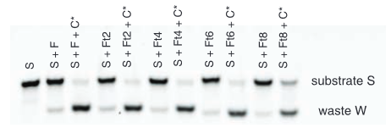
Determination of the driving force
PAGE analysis with truncated fuel F to make waste W unfavourable

Slide 26
Circiuts build on this principle

Slide 27
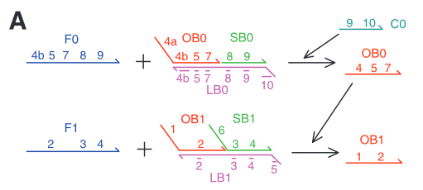
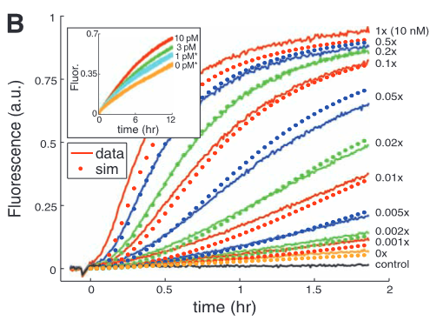
Cascading circuit
Two circuits, one`s output is the catalyst of the second
OB0 is produced linearly with time
Output of the second system is quadratic in time
C0 remains constant

Slide 28
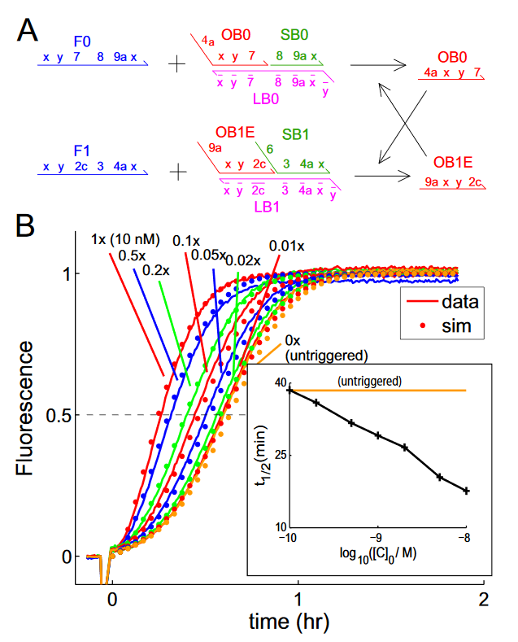
Exponential growth kinetics
Cross-catalytic circiut
Both systems output is the Catalyst of the other
Behaves exponential initially
Log-Plot proves exponential behaviour

Slide 29
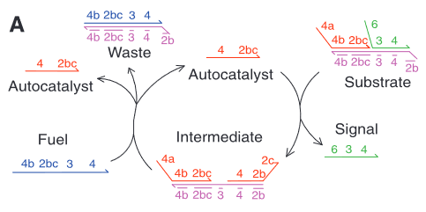
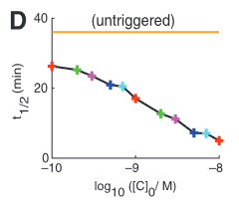
Exponential growth kinetics
Autocatalytic circiut
OB contains C as a subsequenze
Measurements were done using the SR Reporter

Slide 30
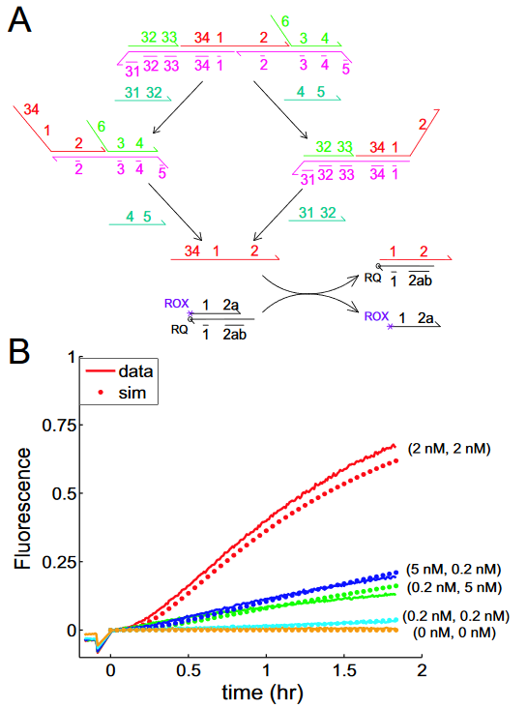
Entropic AND-Gate

Slide 31
Additional remarks
RNA-world: autocatalytic & cross-catalytic self replication reactions important
Possibly a new alternative to PCR
Functional even in presence of naturally occouring macromolecules
Upscaling possible

Slide 32
Summary
Advantages of the proposed method
  Entropy driven: no reactions neccessary
  Outputs may serve as catalysts for other gates
  No complex secondary structure required
  Output and catalysist may be entirely independant in structure
  Larger circiuts can be build upon this principle
  Quadratic and exponential growth can be achieved
  Quick autocatalytic and cross catalytic process

Slide 33
Thank you for your attention

Slide 34
Bibliography
19.7: Free Energy and the Equilibrium Constant, “Chemistry: The Central Science” by Brown, LeMay, Busten, Murphy, and Woodward
“Engineering Entropy-Driven Reactionsand Networks Catalyzed and by DNA” and supporting material; David Yu Zhang,1†Andrew J. Turberfield,2Bernard Yurke,3* Erik Winfree1†
“DNA Hairpins: Fuel for Autonomous DNA Devices”; Simon J.Green, Daniel Lubrich, Andrew J.Turberfield
“Deoxyribozyme-Based Logic Gates”; Milan N. Stojanovic, Tiffany Elizabeth Mitchell, Darko Stefanovic

