Slide 1
HPLC MS analysis of polymerization
Outline:
Overview of RNA polymerization form 2’,3’, cyclic nucleotides
An overview of chromatographic techniques, with a focus on HPLC
Why we need MS analysis for the polymerization?
An overview of MS techniques, with a focus on ESI-ToF
Walk through the Data analysis pipeline

Slide 2
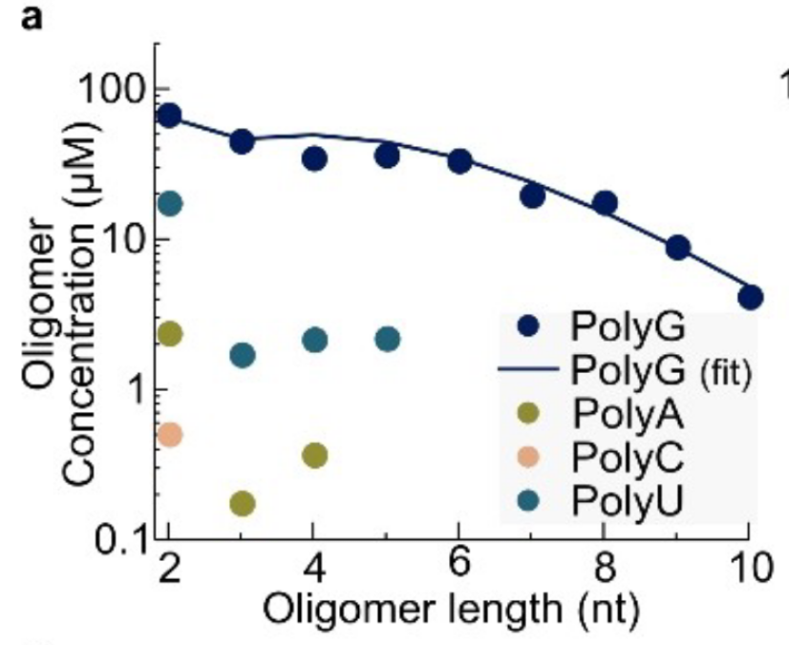
HPLC MS analysis of polymerization
RNA oligomerization from
2′,3′-cyclic nucleotides in a dry state
cNMP + Val: C > A > U > G
cNMP: C < A < U < G
Dass et al., ChemSystemsChem, 2022,e202200026

Slide 3
HPLC MS analysis of polymerization
Nucleotide - 10 mM
Amino acid - 50 mM
pH 10 (with KOH)
Dry 20 h

Slide 4
HPLC MS analysis of polymerization
HPLC: High Performance liq. chromatography

Slide 5
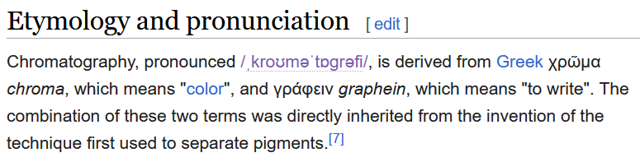
HPLC MS analysis of polymerization
HPLC: High Performance liq. chromatography

Slide 6
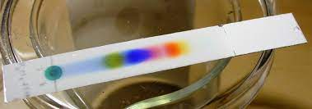
HPLC MS analysis of polymerization
HPLC: High Performance liq. chromatography

Slide 7
HPLC MS analysis of polymerization
HPLC: High Performance liq. chromatography
Lets do chromatography!

Slide 8
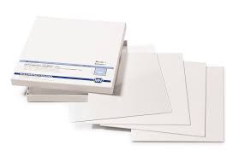
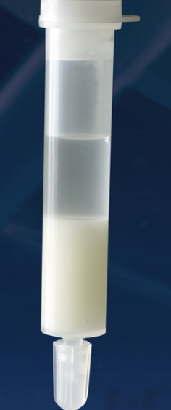
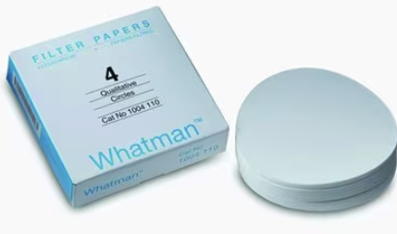
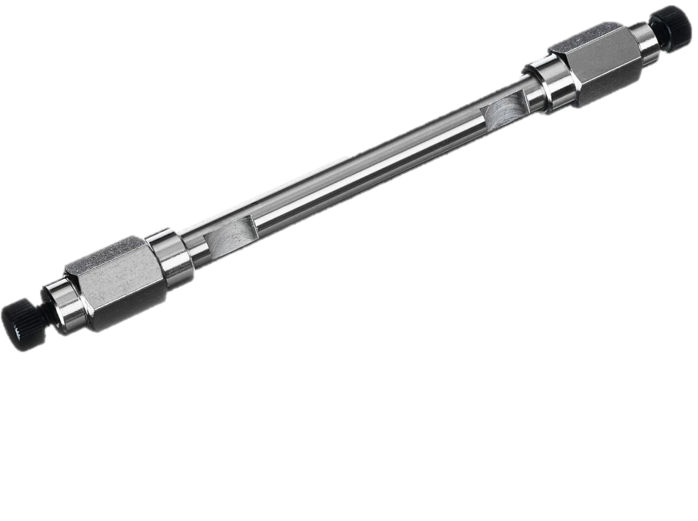
HPLC: High Performance liq. chromatography
Stationary Phase
Mobile Phase
Aqueous buffers
Salt Solutions
Acid/Base Solutions
Organic Solvents
Competing molecule
…

Slide 9
HPLC: High Performance liq. chromatography
Based on the bed
Column
Planar
TLC
Paper
Based on the phase
Gas
Liquid
HPLC
SFC (Supercrit. Fluid)
Mechanism of Separation
Affinity
Ion Exchange
Size Exclusion
Hydrophobicity
Chromatography

Slide 10
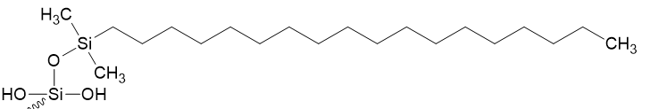

HPLC MS analysis of polymerization
HPLC: High Performance liq. chromatography
Reverse Phase Ion-Pairing Chromatography
Added to the Mobile phase
Creates a bridge between the Stationary Phase and the Sample
Not the NORMAL phase
Stationary Phase: Hydrophobic
Mobile phase: Hydrophilic
Stationary Phase: C18 Column
Mobile Phase: Water and Methanol system with
Ion Pairing agent: Tri ethyl ammine (TEA)

Slide 11
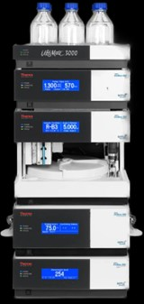
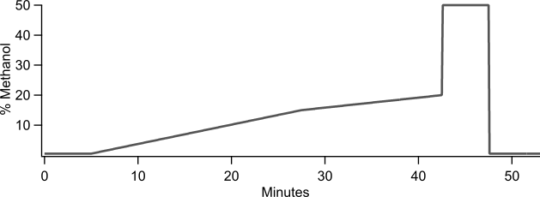
HPLC MS analysis of polymerization
Mobile Phase composition:
200mM HFIP (Acid) and 8mM TEA(Base)
Gradient of Methanol concentration.

Slide 12
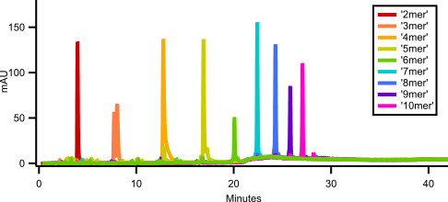
HPLC MS analysis of polymerization
Mobile Phase composition:
200mM HFIP (Acid) and 8mM TEA(Base)
Gradient of Methanol concentration.

Slide 13
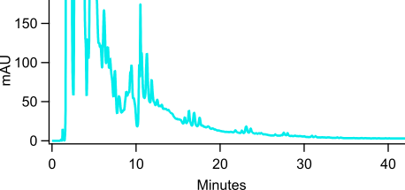
HPLC MS analysis of polymerization: Why?
4
5
6
7 …
HPLC Chromatogram of
Polymerization reaction G+C+A+U + 2.5X Valine pH 10, 20h @ room temp

Slide 14
GCAU 4mers

Slide 15
GCAU 4mers

Slide 16
HPLC MS: Mass Spectrometry

Slide 17
HPLC MS: Mass Spectrometry
Ionization:
Matrix Assisted Laser Desorption ionization (MALDI)
Atmospheric Pressure Chemical Ionization (APCI)
Electrospray Ionization (ESI)
…

Slide 18
HPLC MS: Mass Spectrometry
Ionization:
Matrix Assisted Laser Desorption ionization (MALDI)
Atmospheric Pressure Chemical Ionization (APCI)
Electrospray Ionization (ESI)
…
Mass selection:
Triple Quadrupole mass filter
Orbitrap/ cyclotron resonance
Time-of-Flight
…

Slide 19
HPLC MS: Mass Spectrometry
Ionization:
Matrix Assisted Laser Desorption ionization (MALDI)
Atmospheric Pressure Chemical Ionization (APCI)
Electrospray Ionization (ESI)
…
Mass selection:
Triple Quadrupole mass filter
Orbitrap/ cyclotron resonance
Time-of-Flight
…
Detection

Slide 20
HPLC MS: Mass Spectrometry
Ionization:
Matrix Assisted Laser Desorption ionization (MALDI)
Atmospheric Pressure Chemical Ionization (APCI)
Electrospray Ionization (ESI)
…
Mass selection:
Triple Quadrupole mass filter
Orbitrap/ cyclotron resonance
Time-of-Flight
…

Slide 21
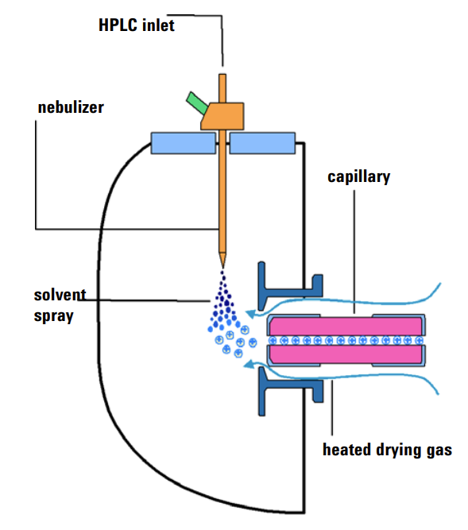
HPLC MS: Mass Spectrometry
Ionization:
Matrix Assisted Laser Desorption ionization (MALDI)
Atmospheric Pressure Chemical Ionization (APCI)
Electrospray Ionization (ESI)
…

Slide 22
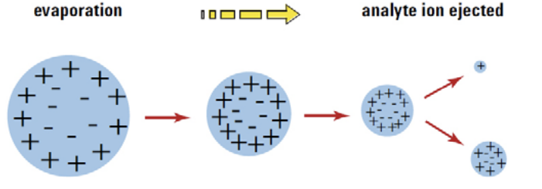
HPLC MS: Mass Spectrometry

Slide 23
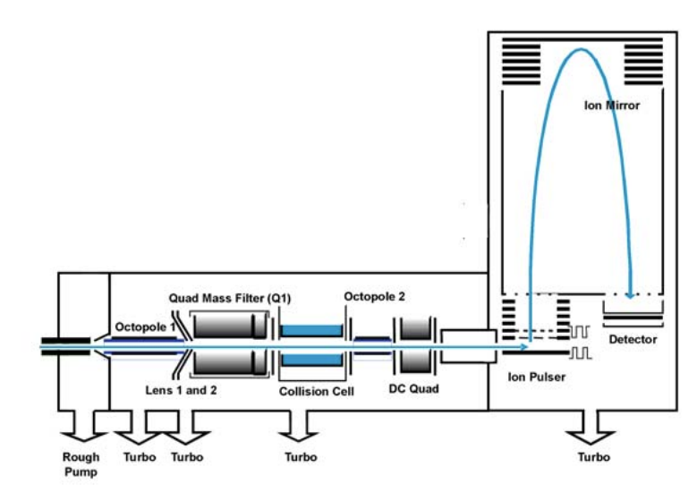
HPLC MS: Mass Spectrometry
Mass selection:
Triple Quadrupole mass filter
Orbitrap/ cyclotron resonance
Time-of-Flight
…

Slide 24
HPLC MS analysis of polymerization: How?
4
5
6
7 …
HPLC Chromatogram of
Polymerization reaction G+C+A+U + 2.5X Valine pH 10, 20h @ room temp

Slide 25
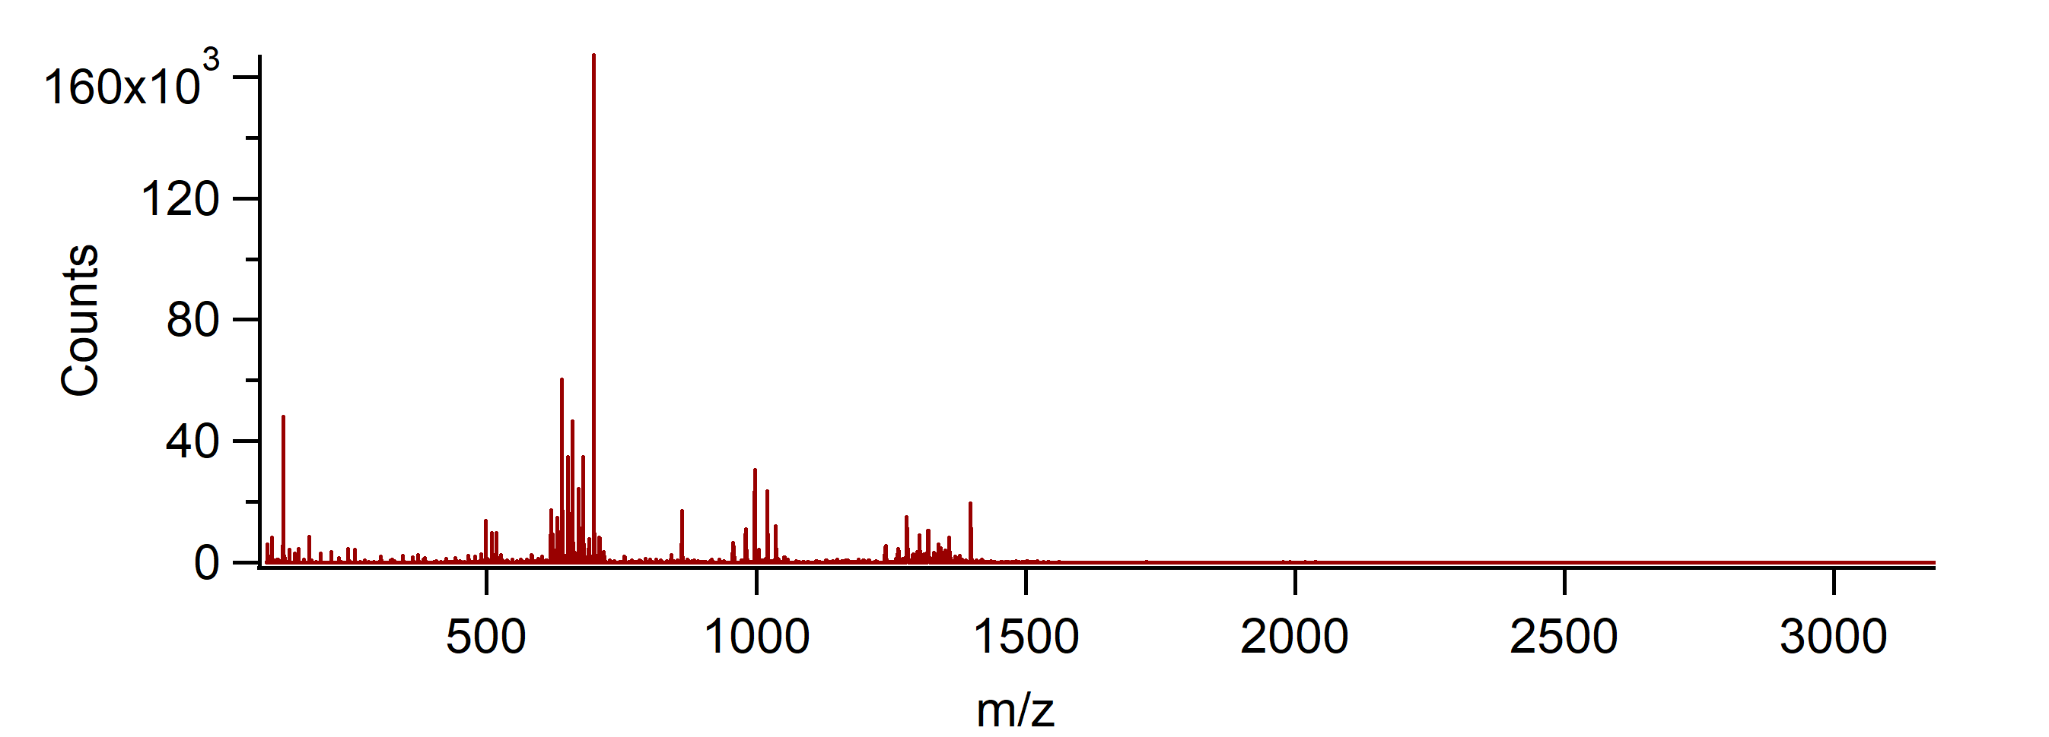
HPLC MS analysis of polymerization: How?
4
5
6
7 …
HPLC Chromatogram of
Polymerization reaction G+C+A+U + 2.5X Valine pH 10, 20h @ room temp

Slide 26
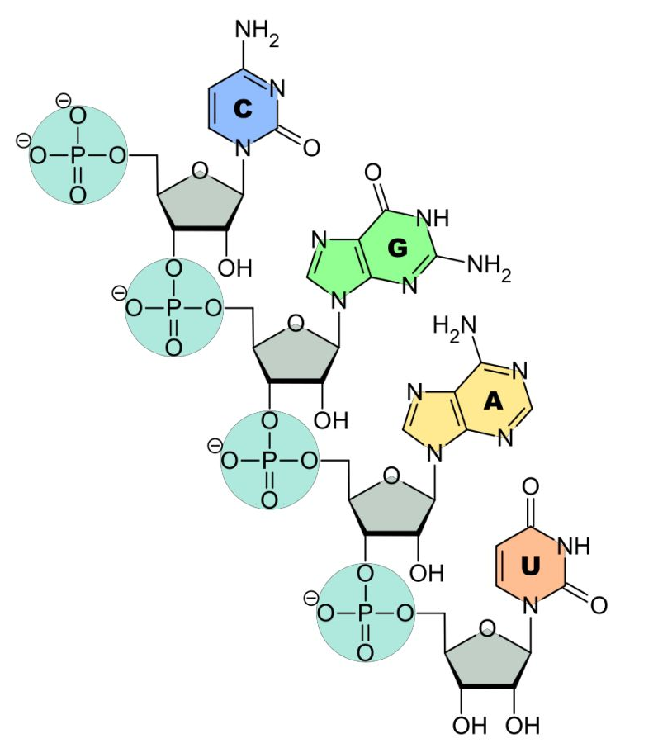
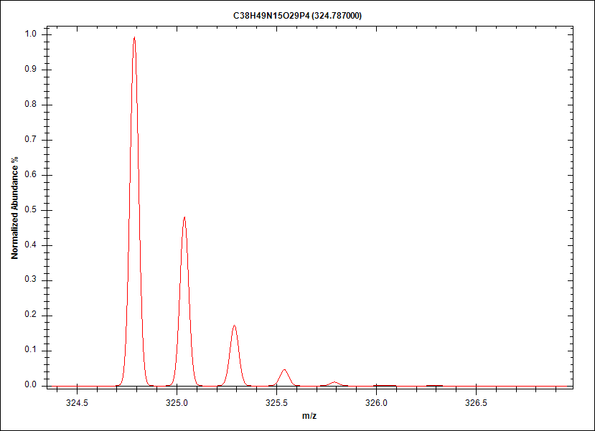
HPLC MS analysis of polymerization: How?
C₃₈H₄₅N₁₅O₂₉P₄ ⁴⁻

Slide 27
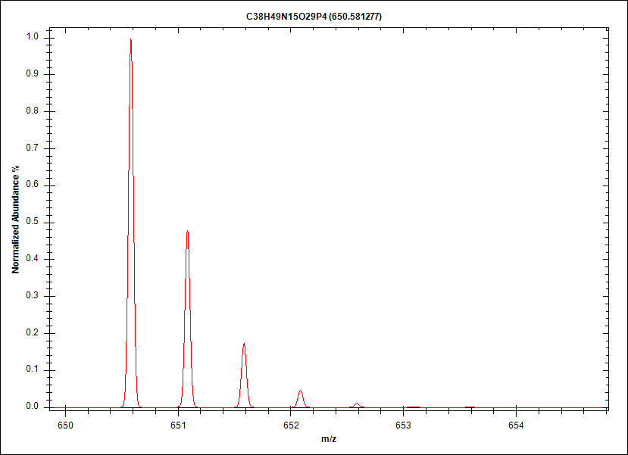
HPLC MS analysis of polymerization: How?
C₃₈H₄₇N₁₅O₂₉P₄ ²⁻
-2 Charge
H+
H+

Slide 28
HPLC MS analysis of polymerization: How?
4
5
6
7 …
HPLC Chromatogram of
Polymerization reaction G+C+A+U + 2.5X Valine pH 10, 20h @ room temp

Slide 29
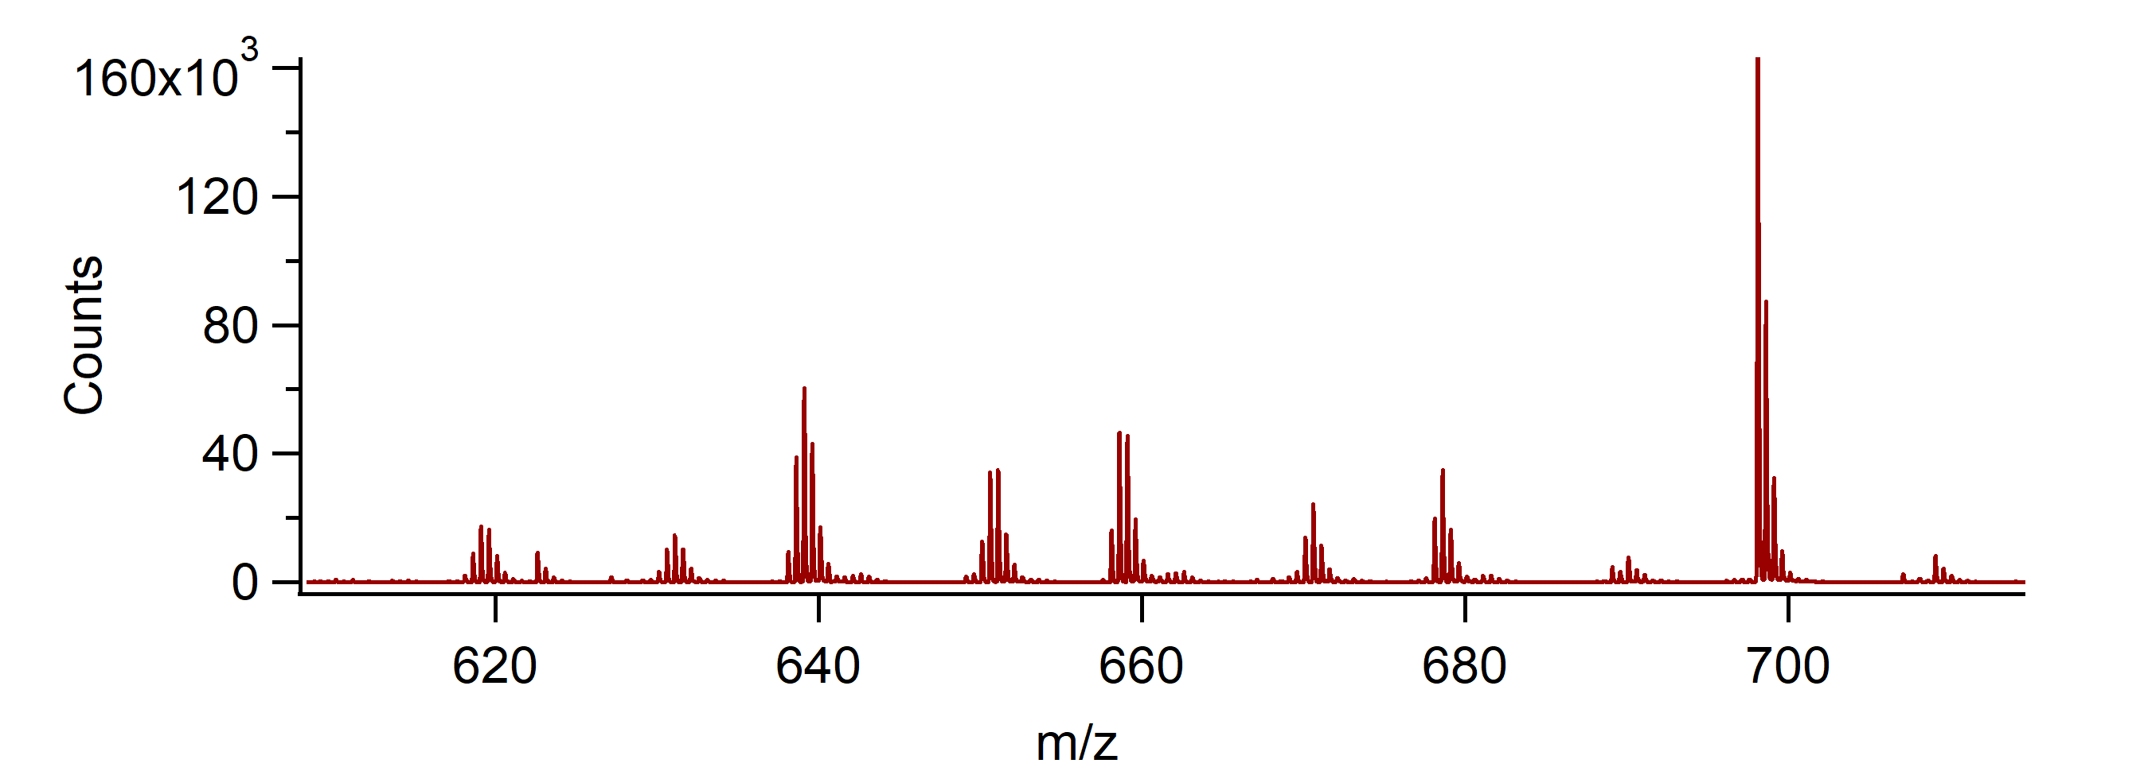
HPLC MS analysis of polymerization: How?
All the 4 mers in the -2 charge states

Slide 30
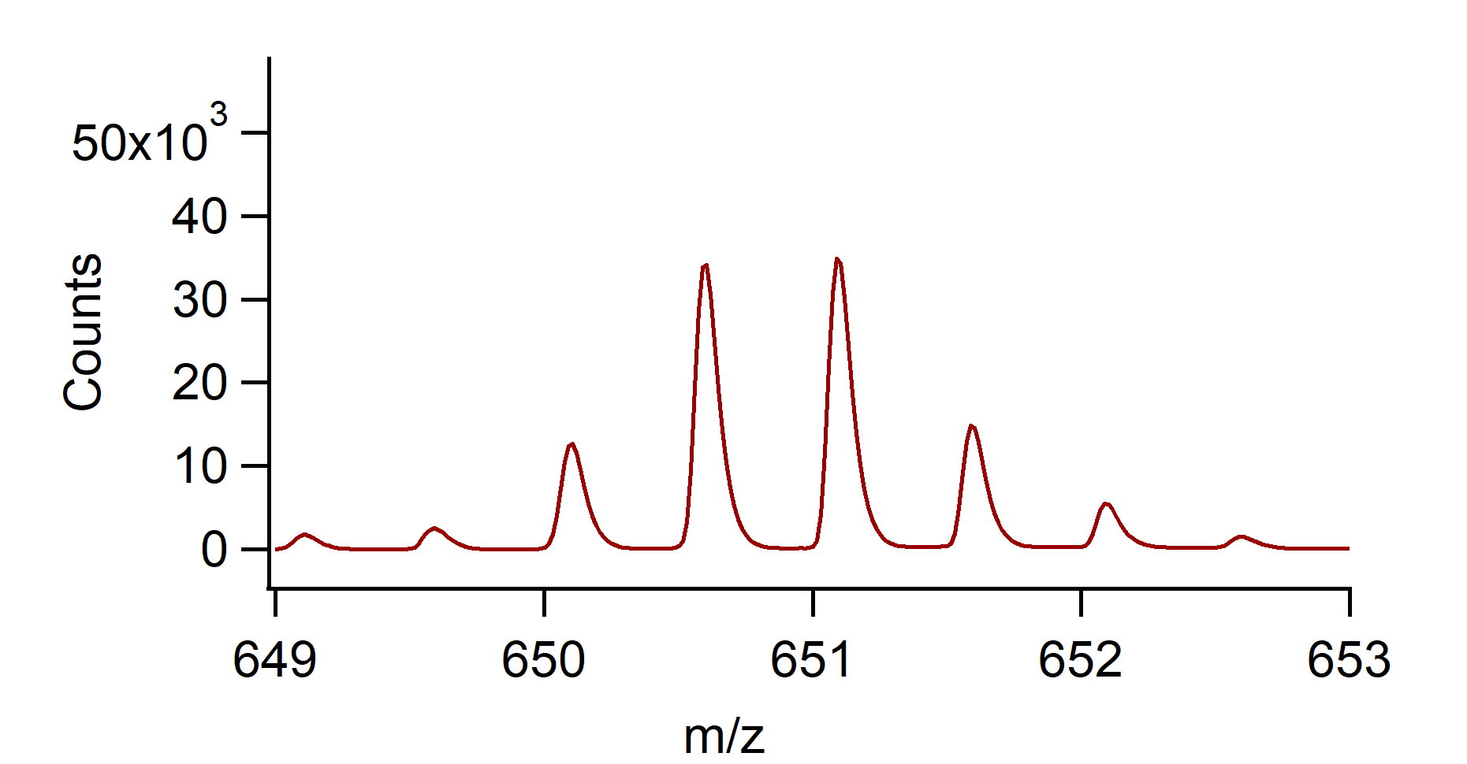
HPLC MS analysis of polymerization: How?
C₃₈H₄₇N₁₅O₂₉P₄ ²⁻

Slide 31
HPLC MS analysis of polymerization: How?
C₃₈H₄₇N₁₅O₂₉P₄ ²⁻

Slide 32
HPLC MS analysis of polymerization: How?
C₃₈H₄₇N₁₅O₂₉P₄ ²⁻
-2 Charge
H+
H+

