Slide 1
Molecular Evolution
in
Prebiotic Environments
CRC 392
Proposal 2024-2027
LMU and TUM

Slide 2
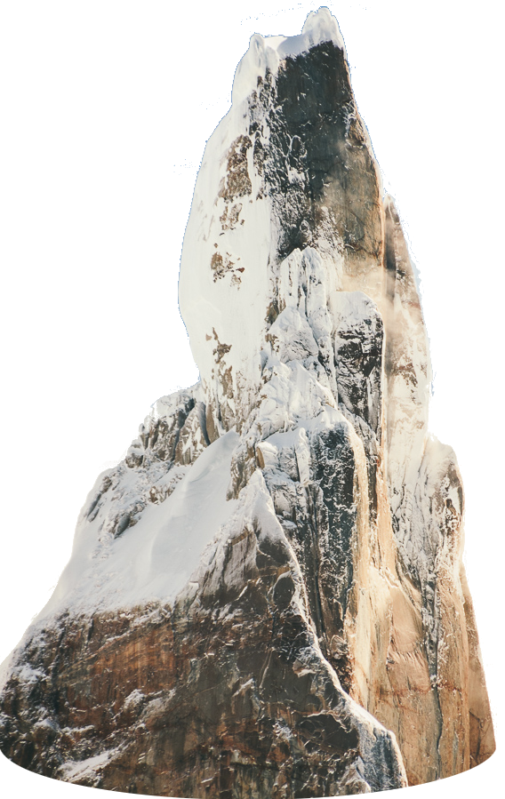
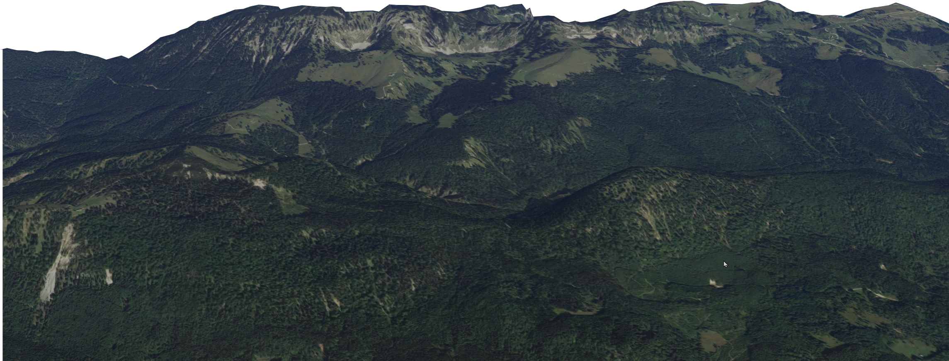
Modern
Life
3.8Ga
Where do we
come from?
Origin
of Life
Biochemistry
Biophysics
Chemistry
Theoretical Physics
Geosciences
Notes:
We are tackling a question that almost everyone has asked already. Where do we come from? But the public knows that science has not yet provided an answer. I think for the credibility of science it is important to close this gap. Here is how we want to do this.

Slide 3
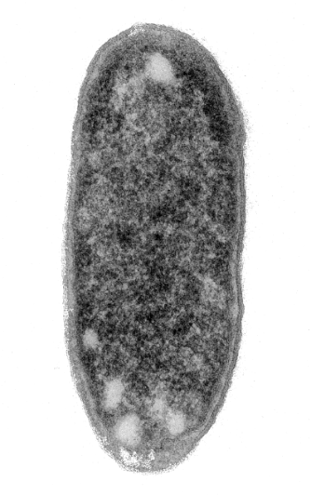
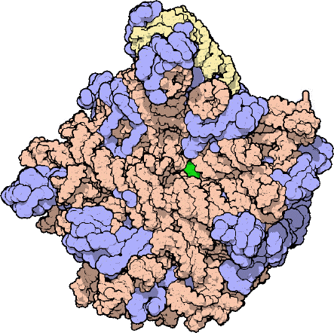
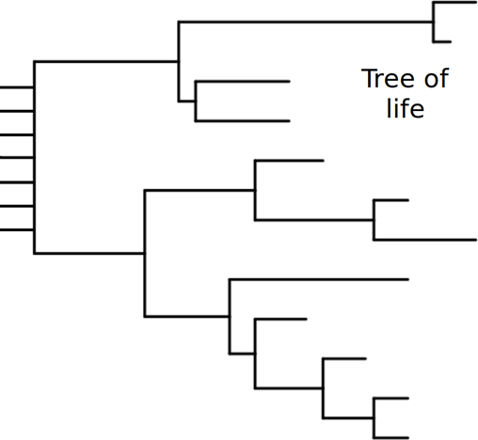
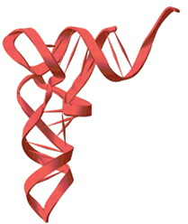
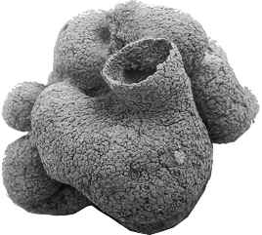
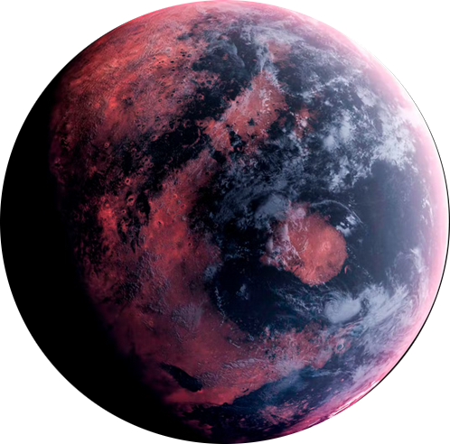
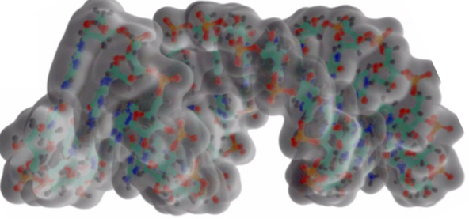
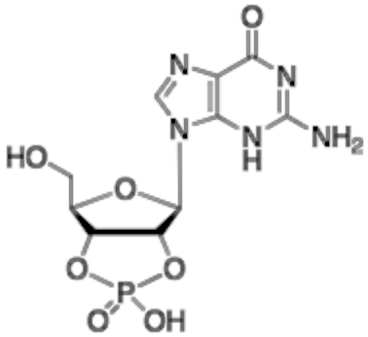
Replication and
Selection towards Function
Modern
Life
Ribosome
3.8Ga
A
Tree of
Life
3.8Ga
Evolution of cell biology
Polymers & Replication
Complexity of Sequences
Bottom-up RNA Catalysis
Towards Protein Evolution
A1,2,3
A4,5,6
A7,8,9
A10,11
Molecular Evolution
Where do we
come from?
3.4Ga
Core
Mechanisms
tRNA
0.6Ga
Time scale
of weeks
Darwinian
Evolution
0Ga
RNA
3.8 -
4.4Ga
Prebiotic Environments
Prebiotic molecules
Origin
of Life
Biochemistry
Biophysics
Chemistry
Theoretical Physics
Geosciences

Slide 4
Replication and
Selection towards Function
Modern
Life
Environments
driving Molecular
Evolution
A
B
Evolution of cell biology
B1,2
B3,4
B5,6,7
B8,9,10,11
Polymers & Replication
Complexity of Sequences
Bottom-up RNA Catalysis
Towards Protein Evolution
A1,2,3
A4,5,6
A7,8,9
A10,11
Planets & Meteorites
Molecular Sources by Volcanism
Geological Compartments
Molecular compartments
Molecular Evolution
Core
Mechanisms
Time scale
of weeks
Prebiotic Environments
Prebiotic molecules
Origin
of Life
Biochemistry
Biophysics
Chemistry
Theoretical Physics
Geosciences

Slide 5
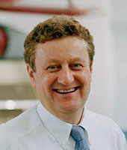
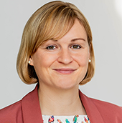
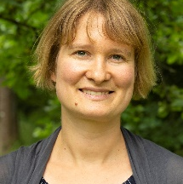
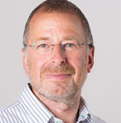
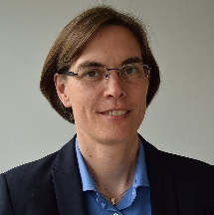
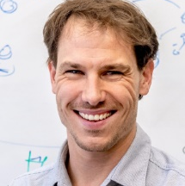
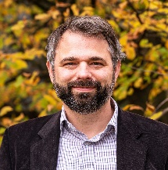
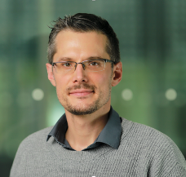
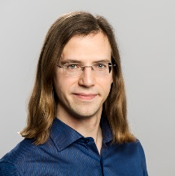
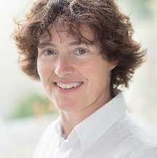
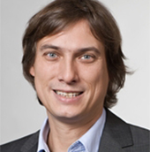
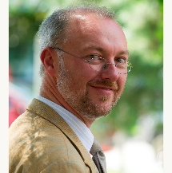
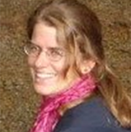
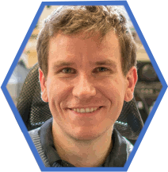
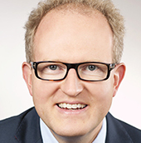
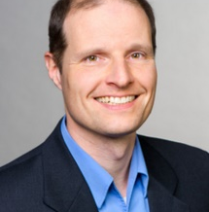
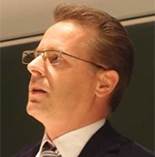
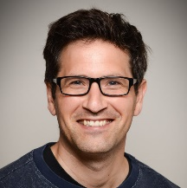
Replication and
Selection towards Function
Public Outreach
Environments
driving Molecular
Evolution
A
B
Heckl
B1,2
B3,4
B5,6,7
B8,9,10,11
Polymers & Replication
Complexity of Sequences
Bottom-up RNA Catalysis
Towards Protein Evolution
A1,2,3
A4,5,6
A7,8,9
A10,11
Planets & Meteorites
Molecular Sources by Volcanism
Geological Compartments
Molecular compartments
Molecular Evolution
Core
Mechanisms
Zeymer
Niederholt-
meyer
Time scale
of weeks
Jäschke
Höbartner
Boekhoven
Göpfrich
Prebiotic Environments
Weber
Storch
Weidendorfer
Biochemistry
Mutschler
Alim
Chemistry
Schwille
Biophysics
Geosciences
Simmel
Braun
Schmitt-
Kopplin
Scheu
Mast
Theo. Physics
Trapp
Gerland
Richert
Ercolano
Orsi

Slide 6
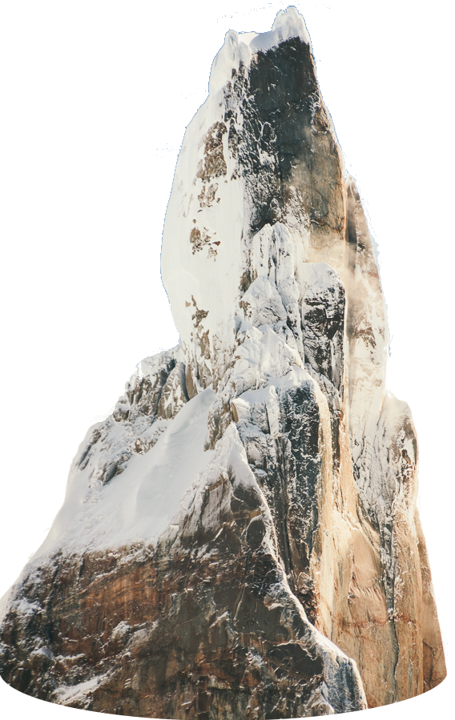
Autonomous
Darwinian
Evolution
12 year Goal

Slide 7
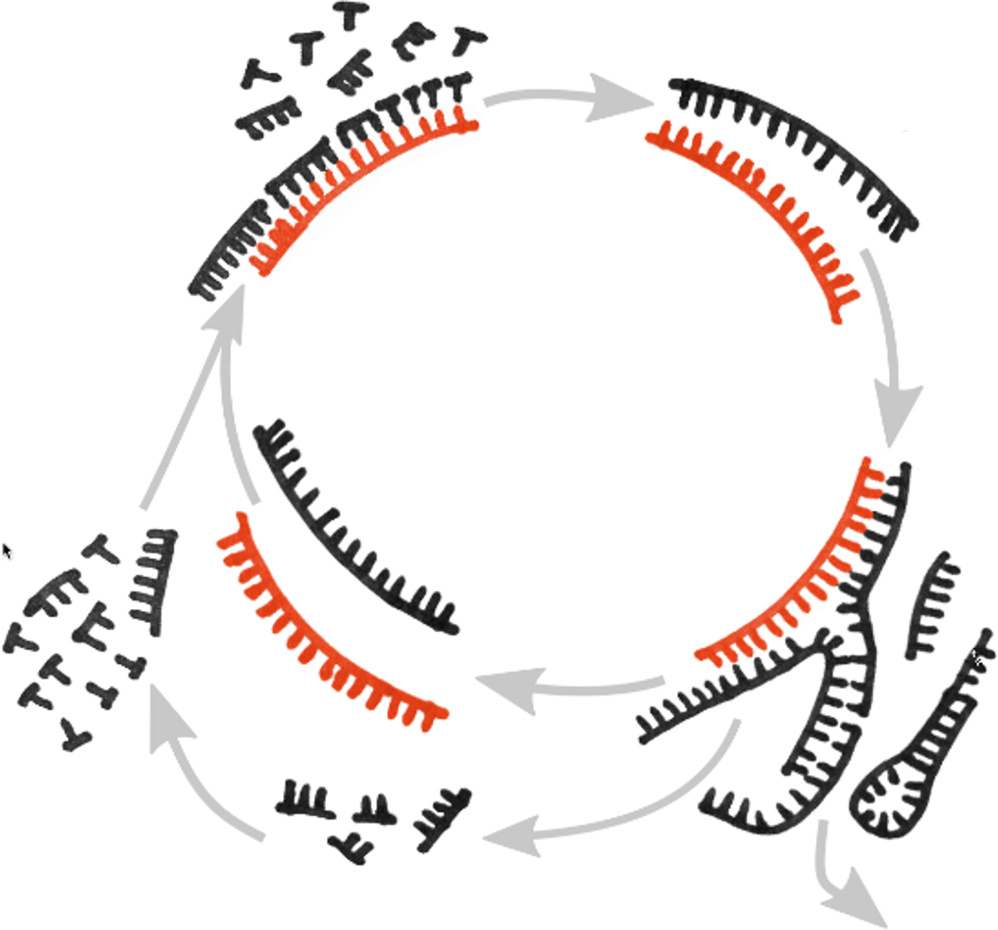
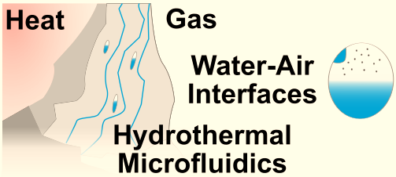
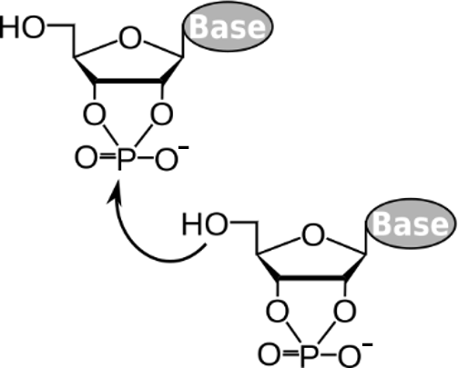
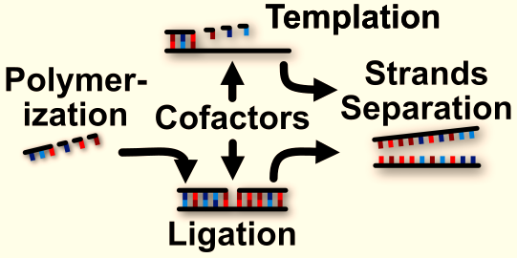
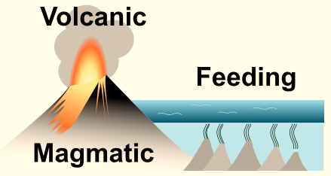
Autonomous
Darwinian
Evolution
12 year Goal
Nonequilibria to
drive reactions
B5,6,7
Geothermal Systems
for RNA reactions
B3,4
Generation and
Replication of RNA
A1,2,3

Slide 8
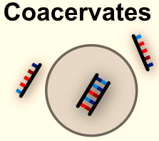
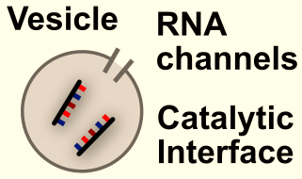
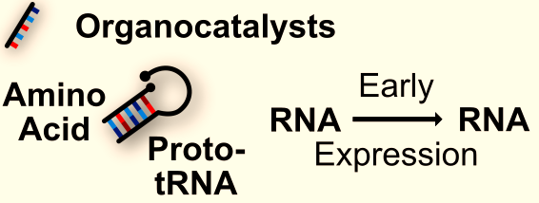
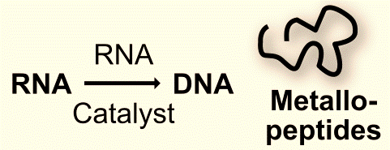
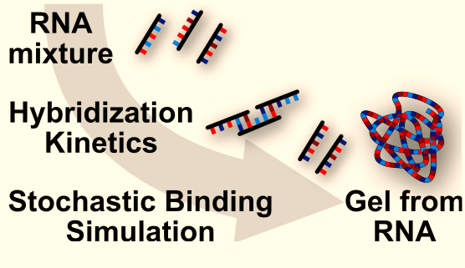
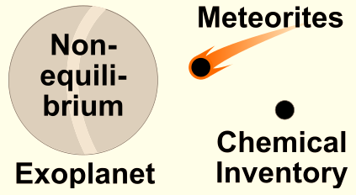
Autonomous
Darwinian
Evolution
B10,11
Selection
with coacervates
Towards
early Cells
RNA Catalysis
and Translation
B8,9
A7,9,10
A4,5,6
RNA Networks and Gels
A8,11
RNA and Peptide
evolution
B1,2
Nonequilibria to
drive reactions
B5,6,7
Astrophysical
foundations
Geothermal Systems
for RNA reactions
B3,4
Generation and
Replication of RNA
A1,2,3

